Slide 1
Quarterly Update on the National Inventory Collaborative
April 29, 2020

Slide 2
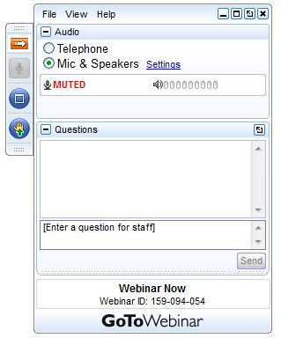
Webinar Ground Rules: Questions?
Each workgroup will give a ~5 minute update describing their work on the 2016v1 platform.
All call participants will remain on mute during the webinar.
Type your questions into the question box on the webinar client.
We will try to answer questions at the end of the webinar.
We will create a Q&A document following the webinar and post with the meeting notes on the Collaborative Wiki: http://views.cira.colostate.edu/wiki/wiki/9169

Slide 3
Agenda for Today
Introduction and Data Distribution
Welcome and introduction (Zac Adelman)
IWDW Update - Platform status and summary of requests (Shawn McClure)
Emissions updates since 2016v1 release last fall
Release updates, Issues Discovered, CMV Correction (Alison Eyth)
New IPM EGU projection (Serpil Kayin)
ERTAC Update (Susan McCusker)
WRAP Oil and Gas Inventory (Jeff Vukovich)
2016v1 platform modeling results
EPA (Norm Possiel and Heather Simon)
LADCO: preliminary model performance for O3 and PM (Zac Adelman)
NY: CMAQ version sensitivity (Jeongran Yun)
WRAP: Regional haze application of the 2016v1 platform
Review exit-survey from last call, next steps, and post-webinar questionnaire

Slide 4
Intermountain West Data Warehouse (IWDW) Update
Shawn McClure, CIRA

Slide 5
2016v1 Release Contents on IWDW
Type | Grid(s) | Models
2016 SMOKE inputs and scripts | 12km, 36km | CMAQ, CAMx
2016 SMOKE outputs by sector (aka pre-merged emissions) | 12km, 36km | CMAQ*
MOVES emission factor tables (2016, 2020, 2023, 2028) | N/A | N/A
Biogenic emissions output from MEGAN | 12km | CMAQ, CAMx
Met data for AQM (same as beta) | 12km, 36km | CMAQ, CAMx
IC/BCs (same as beta) | 12km, 36km | CMAQ, CAMx
Site Compare Files (same as beta) | N/A | CMAQ, CAMx
2023 and 2028 SMOKE inputs and scripts | 12km, 36km | CMAQ, CAMx
2023 and 2028 SMOKE outputs | 12km, 36km | CMAQ, CAMx
NOT YET: AQM-ready emissions
* CMAQ format emissions are produced for each sector;
CAMx format emissions are created after merging CMAQ emissions
Notes:
AQM-ready emissions may not be transferred

Slide 6


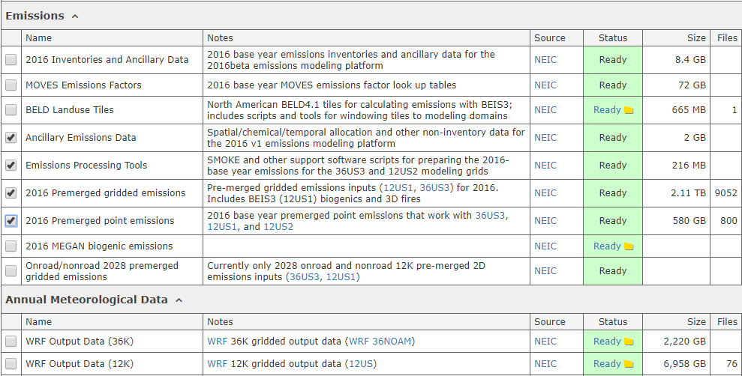
Requesting Modeling Platform Data from the IWDW
Browse to the IWDW Data Request Form: https://views.cira.colostate.edu/iwdw/RequestData
Choose a platform from the dropdown list
Check the components you want

Slide 7
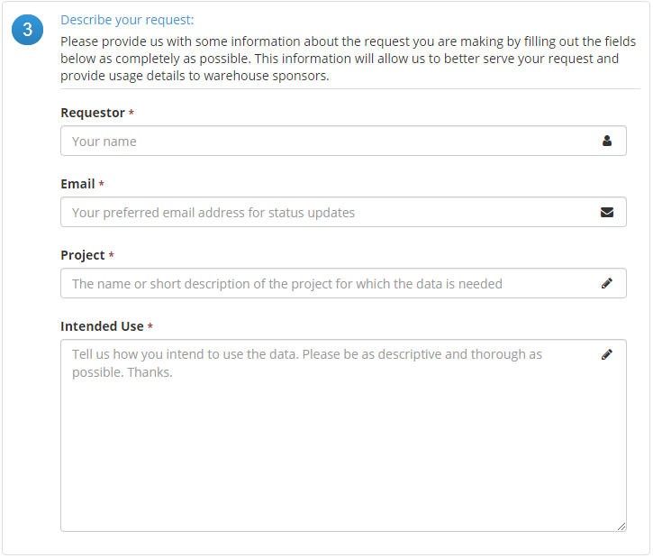
Requesting Modeling Platform Data from the IWDW (…continued)

Slide 8
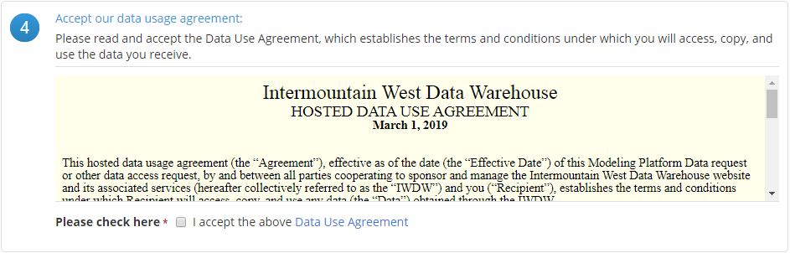
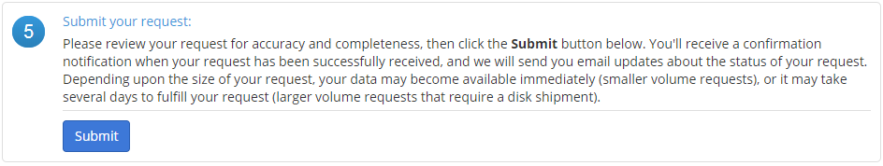
Requesting Modeling Platform Data from the IWDW (…continued)
Accept our basic “data use” agreement
Submit your request

Slide 9
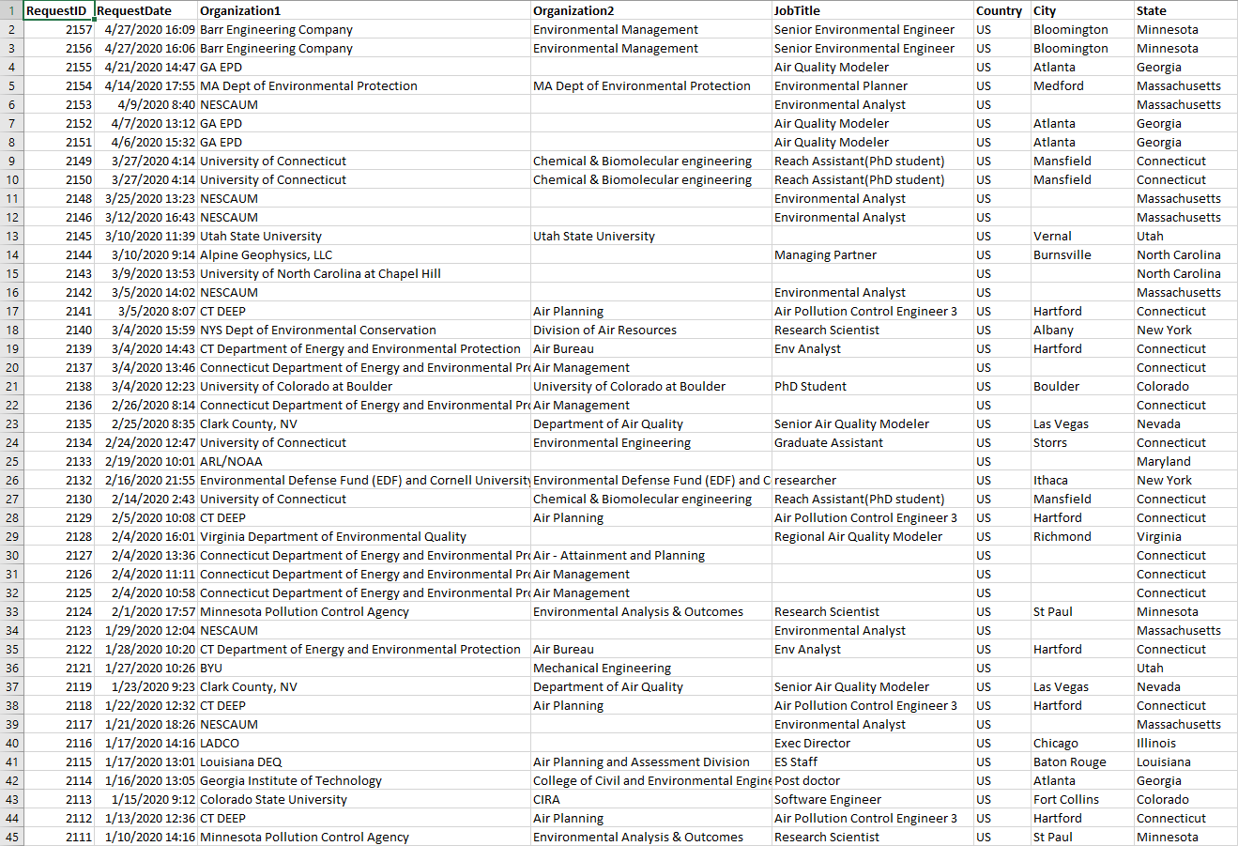
NEIC 2016 v1 – IWDW Data Requests (in reverse chronological order)
About 45 2016v1
requests have been made through
4/28/2020

Slide 10
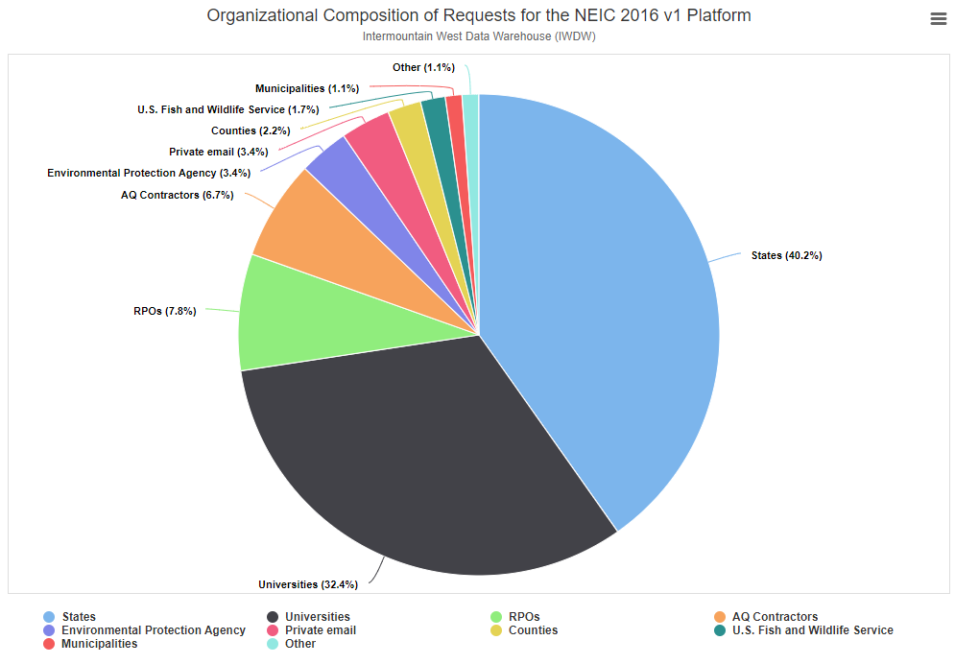
Organizational Composition of Requests for the 2016v1 Platform

Slide 11
Some notes about the IWDW Data Request process
Response times can vary greatly for:
  Non-sponsor platforms
    Many requests will be filled the same day unless the request is for a modeling platform not funded by our sponsors (BLM, USFS, NPS) – in that case, priority must be given to sponsor-funded activities and data requests. We are a small shop (2 developers), so when multiple modeling platforms are “active” it can take a significant amount of time to process, organize, and ship the data for non-SFTP requests (i.e. large-volume requests – see the next bullet)
  Very large volumes of data
    Requests that involve very large volumes of data that cannot be easily serviced via SFTP must be manually shipped by “snail mail” on physical hard drives, a process that can take some time depending upon other pending requests and higher-priority project activities (see the previous bullet)
SFTP is the preferred method of data transfer
  In the case of requests that can be serviced online, the recommended method of data is the Secure File Transfer Protocol (SFTP), which requires the user to download and install their SFTP client of choice.
Online transfer times can vary greatly
  The outgoing connection from the IWDW is a high-bandwidth, high-speed fiber optic connection, but the speed of online transfers is ultimately limited by the slowest leg of the Internet connection between the user and the IWDW file servers.

Slide 12
2016v1 Update, Issues Discovered, and CMV Correction
Alison Eyth, EPA OAQPS

Slide 13
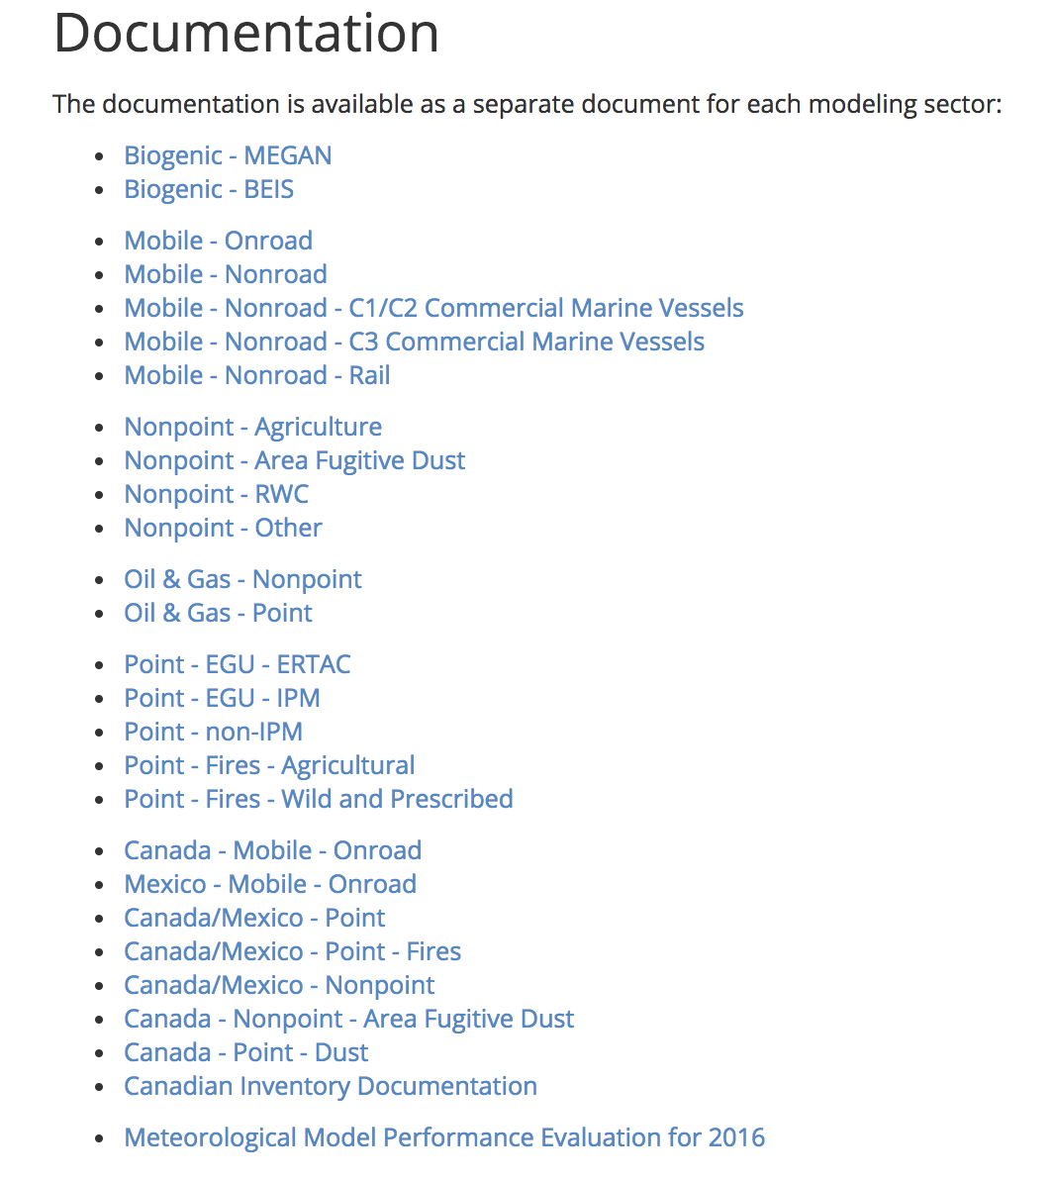
2016 v1 Release Documentation
Final Specification Sheets now Available
27 documents in a standardized format
Describe the sector, the SCCs/sources included in the sector, data sources, processing methods
Graphical and tabular summaries of the data (IWDW, LADCO)
Canadian inventory and Meteorological performance also available
Notes:
Final specification sheets uploaded from December through February

Slide 14
Data Updates and Known Issues
A new page is available from the 2016v1 platform release page that lists data updates and known issues
Data updates include topics to be discussed on this webinar
  WRAP oil and gas data SMOKE inputs and scripts released on IWDW (April, 2020)
  Commercial Marine Vessel (CMV) updates incorporated into release (February, 2020)
  Updated IPM projection from January, 2020 (including flat files)
Known Issues
  Missing emissions from Soberanes fire on July 26, 2016
Coming soon: ERTAC base and future year inventories
Data summaries: ftp://newftp.epa.gov/air/emismod/2016/v1/reports/
  Updated to match new CMV
  Other summaries added periodically as needs are identified
Notes:
More data summaries are added over time

Slide 15
Commercial Marine Vessel Updates since September
The first version of the 2016v1 C1C2 and C3 CMV inventories was released in September
  Some anomalies were found as EPA prepared to use the data
Some days and locations had particularly high values
  Many of the high values were from data being aggregated to a single time step when ships were stationary (aka “hoteling”)
  Hoteling emissions were spread out over the period of the hoteling
    Emissions were truncated if hoteling was > 400 hours
CMV emissions were updated to match day of week from 2017
New C3 and C1C2 inventories were created for base and future years, along with updated run scripts
  Updated SMOKE inputs and outputs are now part of the data on the IWDW
  Also available on ftp://newftp.epa.gov/air/emismod/2016/v1/
Notes:
This was discussed in a little more detail on the January webinar

Slide 16
New IPM EGU Projection
Serpil Kayin, EPA OAQPS

Slide 17
Incremental Updates in the IPM January 2020 Reference Case from the May 2019 Reference Case
Updated Renewable Costs and Capacity Credits
  May 2019 Reference Case with battery storage, solar PV, solar CSP and onshore wind technology cost assumptions from NREL ATB 2019 mid case. The offshore wind technology cost assumptions from NREL ATB 2019 mid case are approximately modeled by scaling the capital costs and FOM in May 2019 Reference Case . The capacity credit assumptions for solar and wind technologies were also updated.
Implemented the following mandates.
  Offshore wind requirements in MD. NJ, CT, MA and NY.
  Clean energy standards in CA, NM, NV, NY and WA,
  RPS updates in CA, DC, MD, ME, NM, NV, NY, OH and WA.
Implemented ACE rule and 45Q.
Implemented NEEDS updates from “NEEDS Quarterly Update for January 2020” which brings over 10 GW of retirements of which 4 GW is coal units.
BART rate limit updates in UT

Slide 18
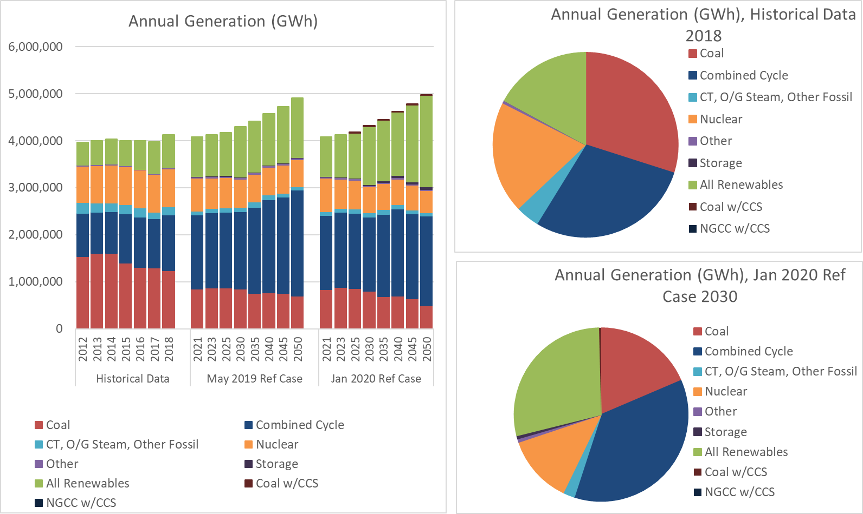
National Annual Generation (Historic, May 2019 and Jan 2020 2019 Reference Cases
*Historical data is still under development.

Slide 19
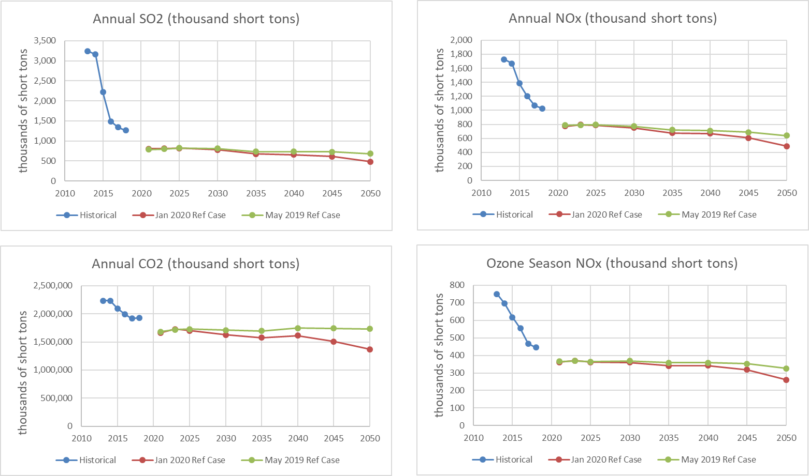
SO2, NOx, and CO2 Emissions in May 2019 and
January 2020 Reference Cases

Slide 20
Change in Ozone Season NO_{X} in 2023 between the Jan 2020 and May 2019 Reference Cases, by state

Slide 21
Change in SO2 emissions in 2030 between the Jan 2020 and the May 2019 Reference Cases, by state

Slide 22
Links for the January 2020 Reference Case
https://www.epa.gov/airmarkets/clean-air-markets-power-sector-modeling
https://www.epa.gov/airmarkets/epas-power-sector-modeling-platform-v6-using-ipm-january-2020-reference-case
https://www.epa.gov/airmarkets/national-electric-energy-data-system-needs-v6
https://www.epa.gov/airmarkets/integrated-planning-model-ipm-results-viewer
https://www.epa.gov/airmarkets/results-using-epas-power-sector-modeling-platform-v6-january-2020-reference-case
  SMOKE input Flat files on this page
Questions?

Slide 23
ERTAC EGU Update
Susan McCusker, MARAMA

Slide 24
ERTAC EGU: Re-cap/Updates
ERTAC EGU option for EGU emission projections
2016; 2023, 2028, and 2020
Since January report:
  Included key updates from Jan. 28 & 30 outreach in current runs
    Updates to off-line dates (MO, IN, IA, MS, and NC)
    A few updates from IA (e.g., nominal heat rates, lat/lon, on-line date)
    A few NOx and SO2 control updates (e.g., control start date, rate)
    Remaining updates rolled into next version

Slide 25
ERTAC EGU: ERTAC Platform files
2016v1 ERTAC EGU SMOKE processing package
  NYDEC developed, LADCO & VA DEQ tested run scripts for “ERTAC platform package” SMOKE processing
  Two-page instructions + documentation
  Future years in progress
  Files together in one easy-to-swap parallel package
2016v1 IPM platform package includes:
2016v1 ERTAC platform package includes:
2016fh_16j/inputs/ptegu/
egucems_2016b + hourly temporalization
egunoncems_2016b
2016fh_16j/inputs/ptnonipm/
*nonegu_2016v1
*biorefinery
pt_railyards
2016fh_16j/inputs/ptertac
ERTACv16.0 + hourly temporalization
egunoncems_ERTACv16.0
2016fh_16j/inputs/ptnonertac
*nonegu_2016v1_ERTACv16.0
*biorefinery
pt_railyards

Slide 26
ERTAC EGU: Next 2016-based version
Bring in units that report to CAMD but are non-EGUs or burn non-fossil fuel
ERTAC/CAMD to NEI crosswalk updates – Emily Bull (MDE)
  CAMD ORIS and Boiler IDs to EIS facility-unit IDs
  Prepare emissions inventories for photochemical modeling
  Ensure units in correct inventory files, not double counted or missed
  CA, CO, IA, IL, KY, MI, MN, ND, NY, OH, OK, OR, PA, TN, TX, WY (4/13)
Non-NOx/SO2 pollutant emission rate updates – Emily Bull
  Higher than expected number of units getting default rates
  Working with CAMD
    PM rates updated in Jan 2020 IPM, other pollutants to follow

Slide 27
WRAP Oil and Gas Inventory
Jeff Vukovich, EPA OAQPS

Slide 28
COLLABORATIVE VS. WRAP OIL AND GAS INVENTORIES
2016 version 1 Collaborative Workgroup
  Non-point developed with Oil and Gas Tool using 2016 activity data
    Colorado based on 2014NEIv2
    WRAP states didn’t submit data
  Point sources
    Type A major sources: 2016 year specific
    Other: Growth sources assumption from 2014 to 2016
  Lower 48 states plus Alaska
    CA, PA and OK provided alternative/modified data
  Future years: 2023 and 2028
WRAP 2014 Baseline
  Point and non-point using 2014 activity data
  Developed using basin specific studies post-2014NEI
  Did not use the O&G Tool
  Used data from recent survey
    Circa 2017
  7 WRAP States: CO, MT, NM, ND, SD, UT and WY
  Future year: same case used for 2023 and 2028
  Provided own gridding surrogates and some speciation information
28

Slide 29
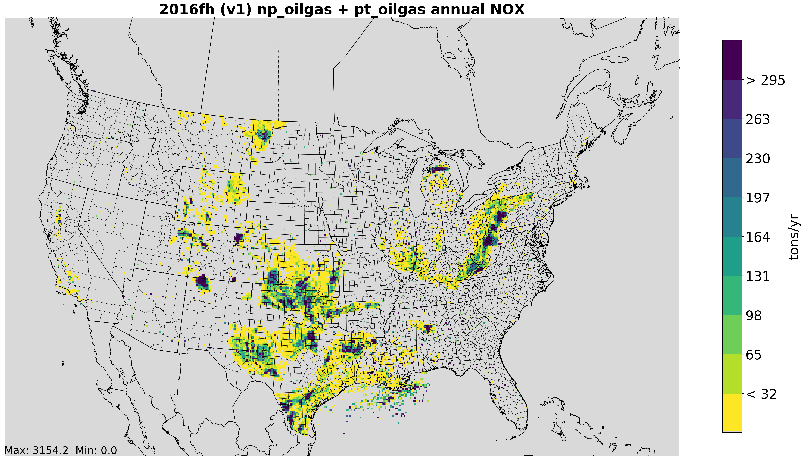
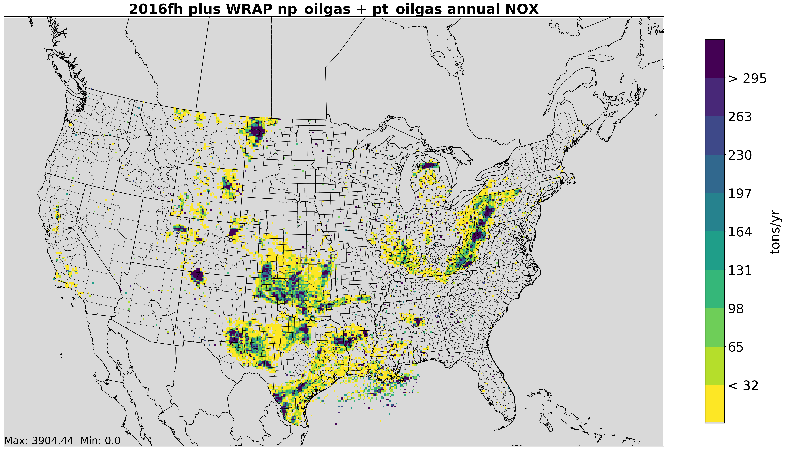


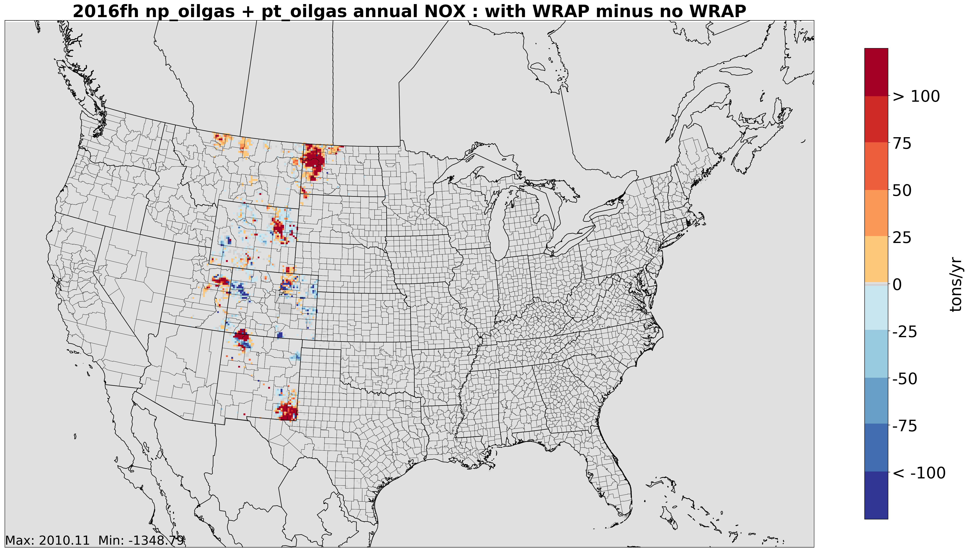

2016V1
2016V1 with WRAP2014
NOx
Point +
Nonpoint
Using WRAP2014 – 2016v1 : NOx
Using WRAP2014 – 2016v1 : VOC
Red = WRAP values higher
Blue = 2016v1 values higher

Slide 30
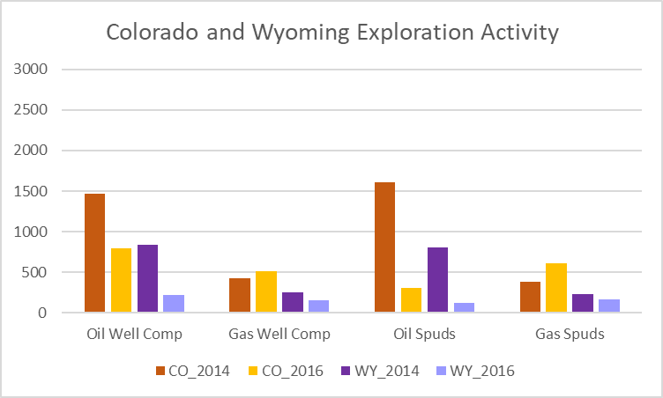
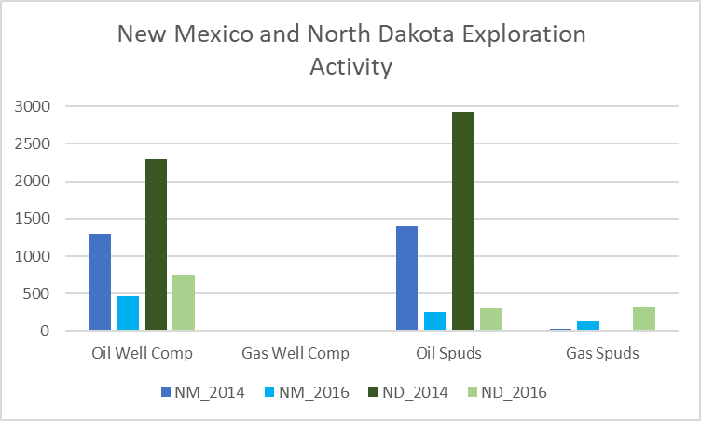
HISTORICAL EXPLORATION DATA AND TRENDS
Overall Oil Exploration down somewhat significantly in 2016 when compare to 2014.
Natural Gas Exploration trends variable in these states.
Sources above are: DrillingInfo’s HPDI database
WRAP used IHS ENERDEQ data for exploration information
30

Slide 31
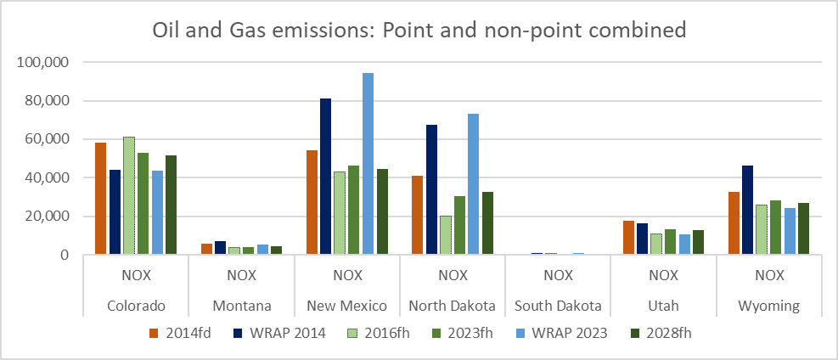
StATE NOX EMISSIONS FOR BASE AND FUTURE CASES
2014fd = 2014NEIv2 2016fh = 2016v1 2023fh and 2028fh are based off of 2016v1
Notes:
New Mexico differences attributed to higher pipeline transportation emissions and also some inclusion NG Liquids emissions from ptnonipm sector. North Dakota differences attributed to exploration 2014 vs 2016 differences and new survey info being used.

Slide 32
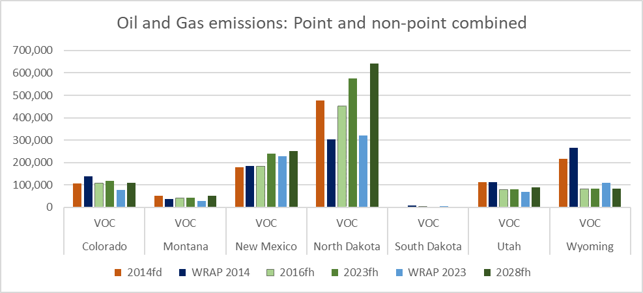
StATE VOC EMISSIONS FOR BASE AND FUTURE CASES
2014fd = 2014NEIv2 2016fh = 2016v1 2023fh and 2028fh are based off of 2016v1
Notes:
Oil Tanks flashing/standing/venting differences in ND. Wyoming differences mainly a venting event during completions (exploration differences)

Slide 33
SUMMARY
Differences between WRAP2014 and 2016v1 can mainly be attributed to
  2014 vs 2016 activity
  Recent survey information (circa 2017)
  Post-2014NEI basin-specific studies
WRAP2014: +100K tons in NOX and VOC vs. 2016v1
WRAP2023: +75K tons in NOX and -300K tons of VOC vs 2023fh
WRAP inventories have been processed through SMOKE for base and future year
  Data package prepared and provided to IWDW
  IWDW will make it available via their website
  Documentation
    Technical reports available via WRAP
    WRAP developing specification sheet documentation
33

Slide 34

EPA OAQPS
2016v1 Modeling Update
Norm Possiel and Heather Simon, EPA OAQPS

Slide 35
AQ Modeling Inputs and Set-up
component | Details | Reference
Emissions case | 2016v1 (2016fh)* | http://views.cira.colostate.edu/wiki/wiki/9169
Meteorology | WRF v3.8 | http://views.cira.colostate.edu/wiki/Attachments/Inventory%20Collaborative/Documentation/2016beta_0311/MET_TSD_2016.pdf
Meteorology post-processing | wrfcamx; MCIP v4.3 (“16j”) | http://www.camx.com/files/camxusersguide_v6-50.pdf; https://www.geosci-model-dev.net/3/243/2010/gmd-3-243-2010-discussion.html
IC/BC | 2016fe hemispheric CMAQv5.2.1 paired with CMAQ/CAMx 36US3 CONUS | https://cmascenter.org/conference//2018/slides/0850_henderson_hemispheric-cmaq_application_2018.pptx
Model (chemical mechanism) | CAMx v7 beta (cb6r4_CF); CMAQv5.3.1 (cb6r3/AERO7)** | http://www.camx.com/; https://www.epa.gov/cmaq/cmaq-models-0
domains | 36US3 & 12US2 CONUS | See next slide
Layers | 35 vertical layers (no layer collapsing)
*With updates to CMV sector described on slide 4
**Note CMAQv5.3.1 bug preventing use of certain types of emissions files

Slide 36
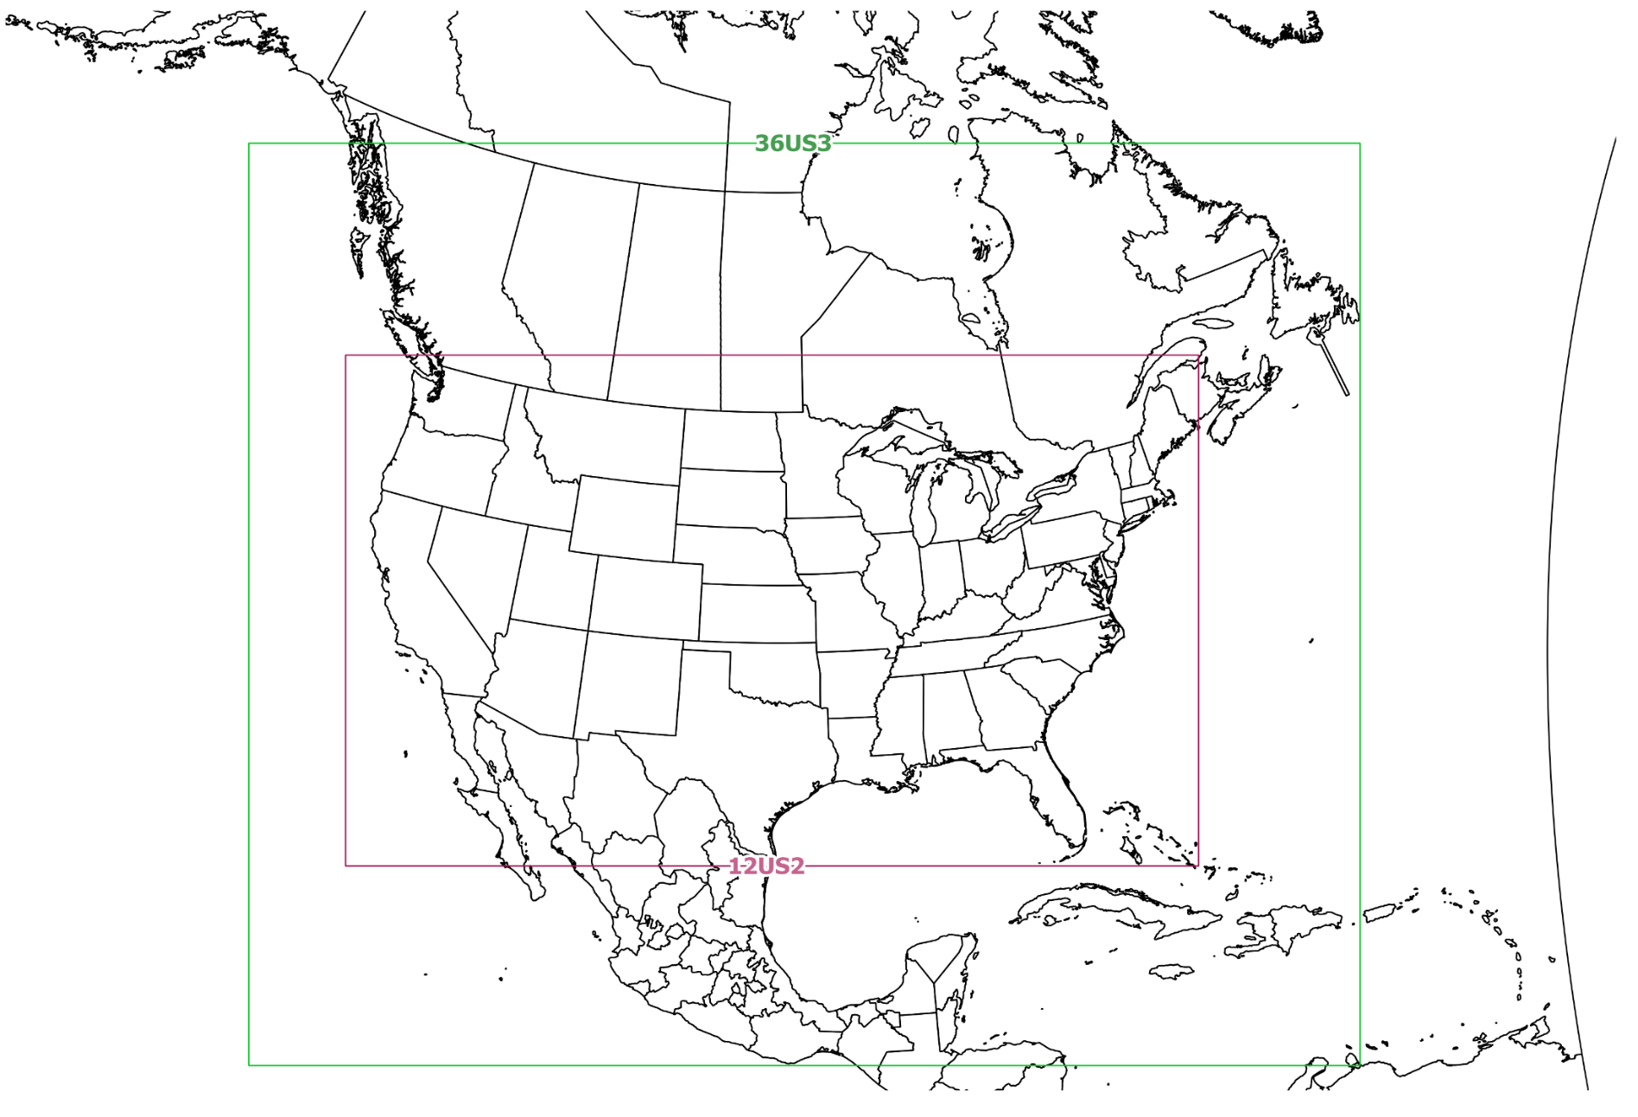
36km and 12km Model Domains
36US3
12US2

Slide 37
Base Simulation CMAQv5.3.1 Science Options
Chemical mechanism:
  CB6r3_ae7_aq
  Updated to AERO7for PM treatment for traditional SOA formation, non-volatile POA, no pcSOA
  Marine halogen O3 destruction
No lightning NO emissions
No windblown dust emissions
Mixing & PBL options
  Variable Kzmin based on land-use
  P-X PBL shceme
M3DRY deposition scheme, no NH3 bidirectional flux

Slide 38
Planned CMAQ sensitivity runs testing science options and inputs
Deposition scheme & Bidirectional NH3 flux:
  STAGE no bidi
  M3DRY BIDI bidi
  STAGE bidi
Lightning NO
Windblown dust
Meteorological treatment
  Static Kzmin = 1 for all land-use types
  WRFv4.1.1, includes new hybrid vertical structure (domain following near surface and isobaric aloft). This may impact estimates of:
    stratospheric intrusions
    mixing from the free troposphere and importance of transport
  Noah-YSU PBL scheme
  Update to land/water grid cell definition for 12km grid cells with high NOx emissions
Updated VOC speciation
GEOS-Chem boundary conditions

Slide 39
Base Simulation CAMxv7 beta6
Science Options
Chemical mechanism: CB6r3
One-way nesting
No lightning NO emissions
No windblown dust emissions
Zhang03 deposition scheme, no NH3 bidirectional flux

Slide 40
Planned CAMx sensitivity runs
Kv sensitivities
  “CMAQ”-like Kv scheme vdif files
  “ACM2” Kv scheme vdif files
All elevated point source files sensitivity
Ammonia deposition sensitivities
  rscale = 1
  Bidirectional NH3 flux
GEOS-Chem boundary condition

Slide 41
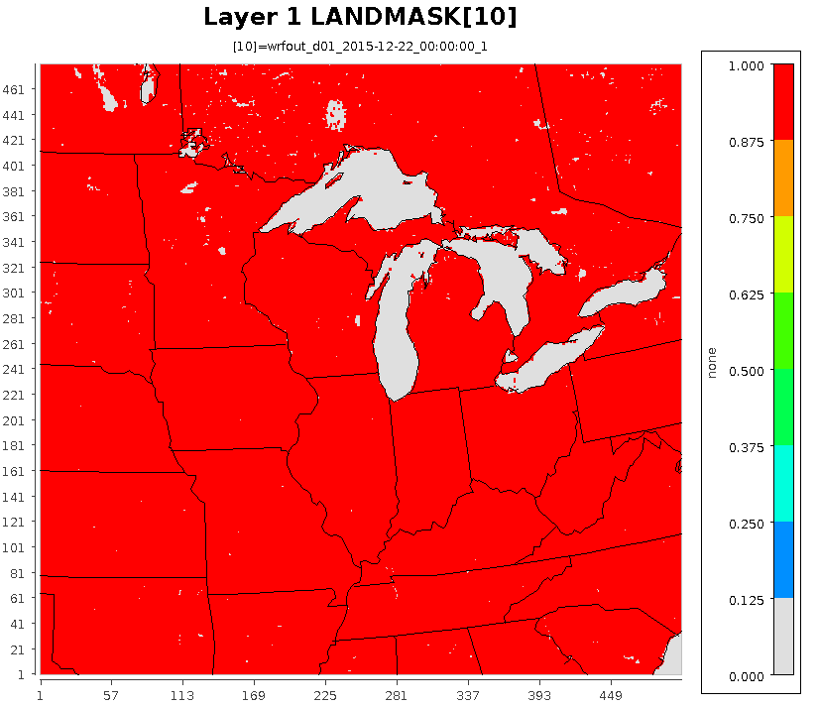
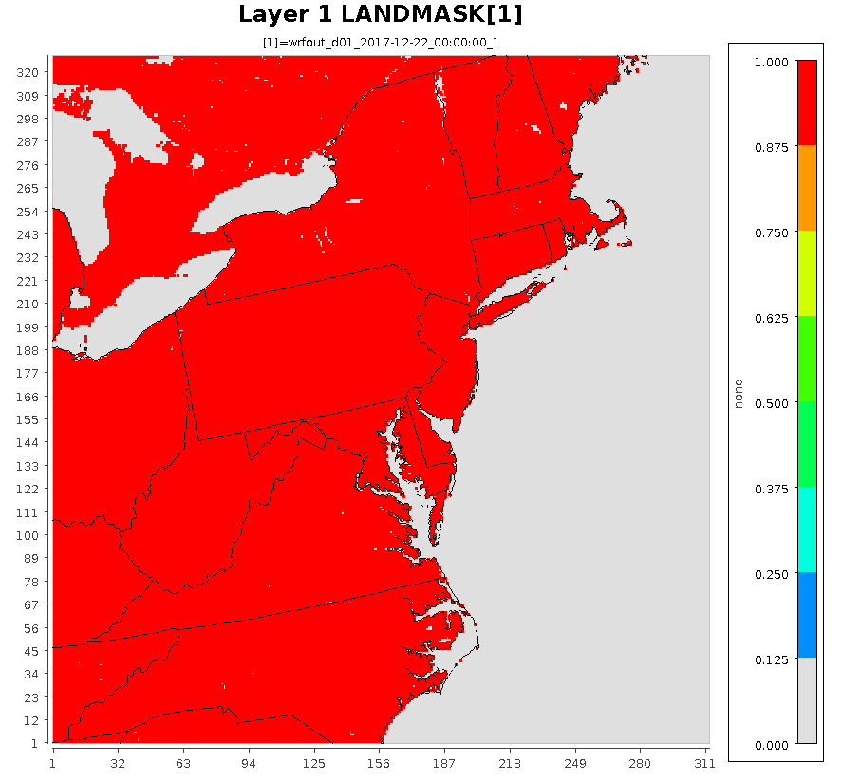
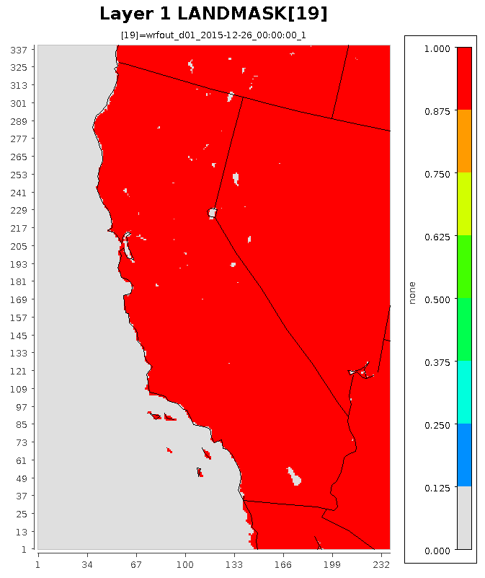
EPA WRF 4-km Domains

Slide 42
Status of simulations and evaluation
Base CMAQ and CAMx simulations complete, evaluation ongoing
Sensitivity simulations underway
4km simulations will likely wait until final configuration is determined based on other sensitivity runs

Slide 43
Model evaluation plans
Not planning to recreate > 200,000 plots that were uploaded to LADCO server from the 2016 beta simulation
Feedback from forum members about most useful plots from IN and NC
  Kelly plots
  Region-wide averaged CO time
Evaluation will likely focus on
  Tables of performance statistics by region/season/species/monitoring network
  Kelly plots
  Spatial dot maps of NMB/NME
  Boxplots of monthly observed and modeled concentrations
  Other?

Slide 44
Initial Look at Ozone Evaluation Results for 2016v1 CMAQ and CAMx Base Year Simulations

Slide 45
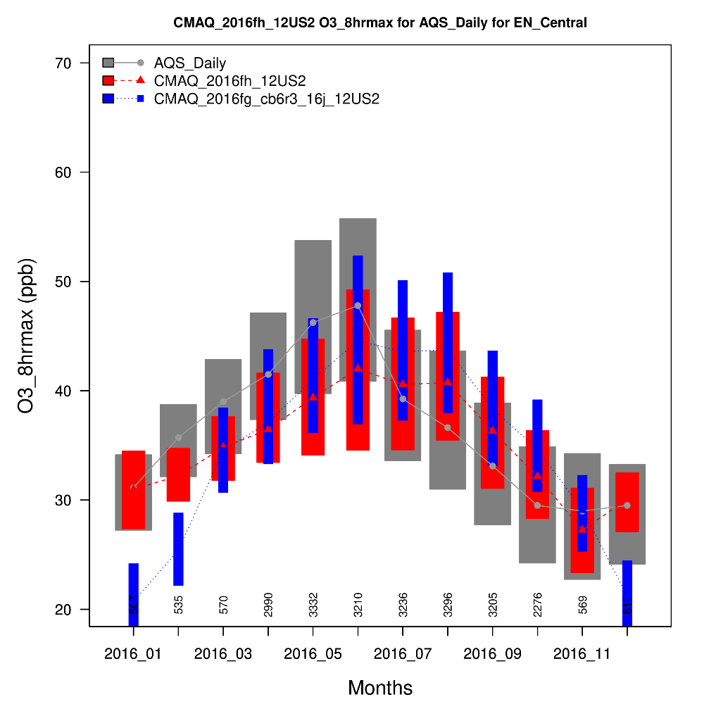
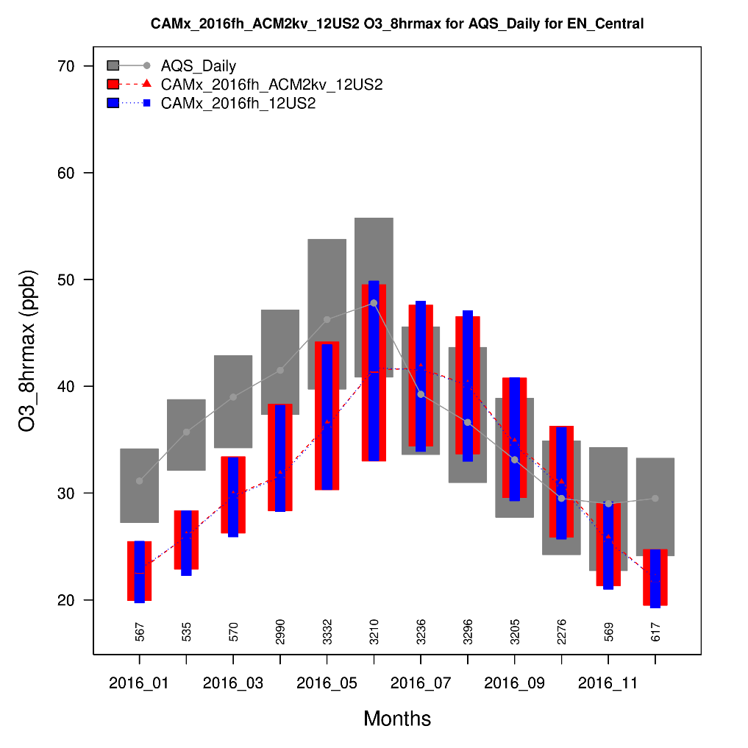
MDA8 Ozone by Month: Upper Midwest Region
CMAQ
CAMx
Obs MDA8 peaks in May and June followed by a sharp decline in July
Both CAMx and CMAQ tend to under predict, except for July thru October

Slide 46
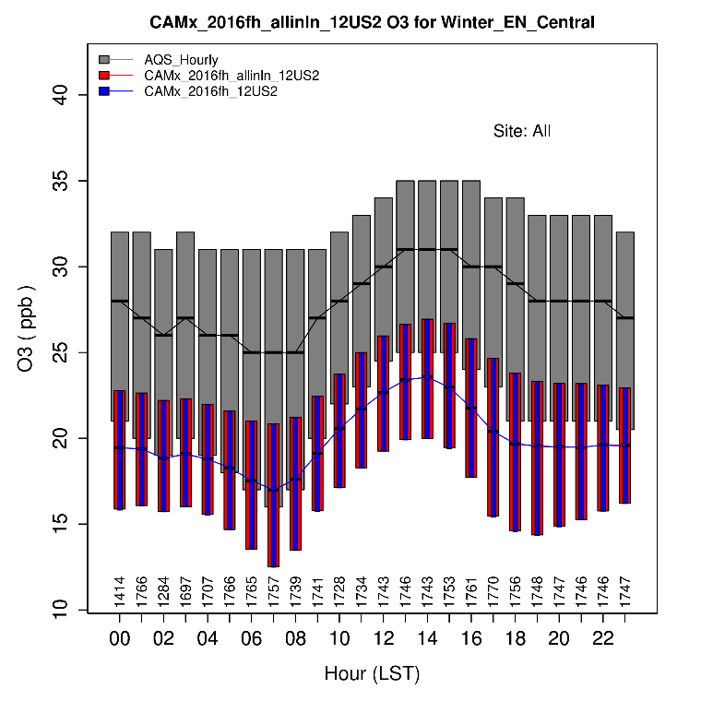
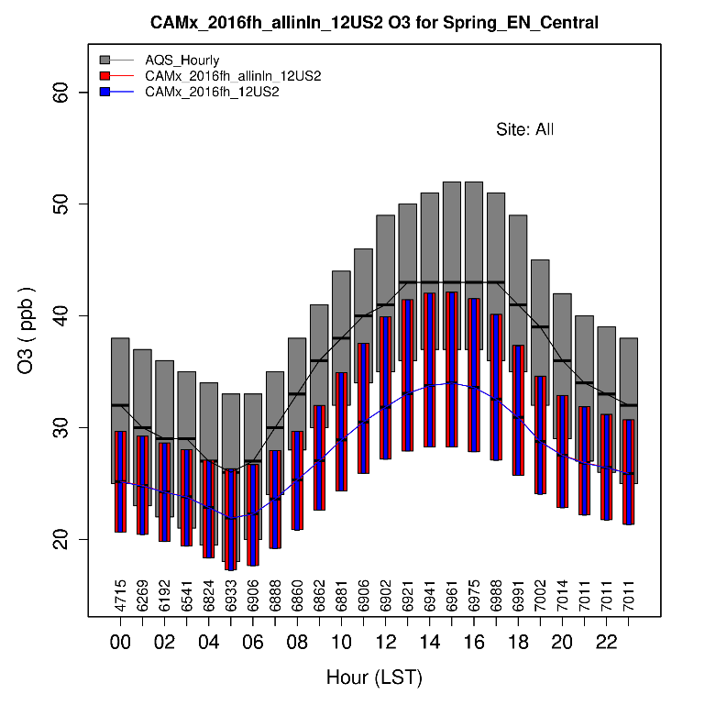
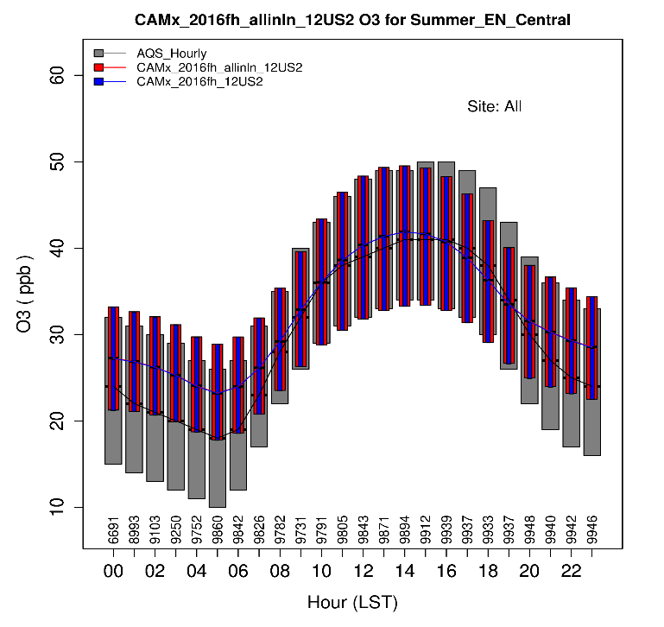
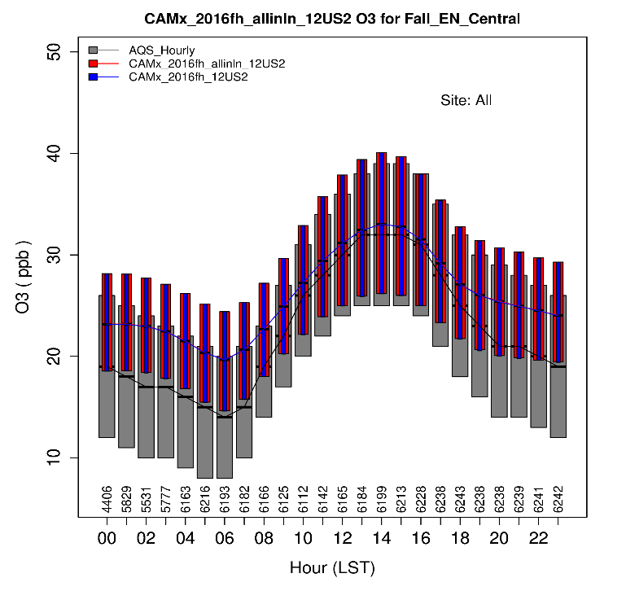
Hourly Ozone by Season CAMx: Upper Midwest Region
Winter
Spring
Winter and Spring: Under prediction during all hours
Summer:
Model replicates inter-quartile range, except for over prediction of low nighttime obs
Fall:
Over prediction during the morning and evening transitions and over night
Summer
Fall
*Note that scales differ on the plots for each season

Slide 47
CAMx 2016v1 Model Performance Evaluation Results for Ozone
Zac Adelman, LADCO

Slide 48
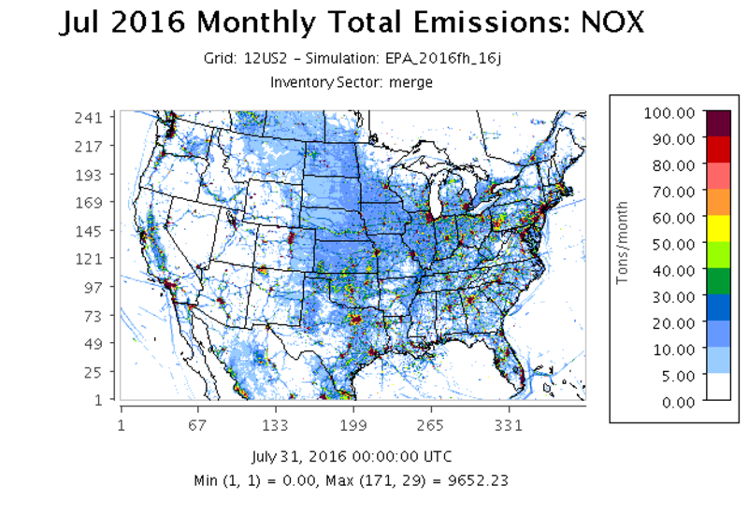
LADCO 2016v1 CAMx Modeling
April – October 2016 CAMx v7.0beta4
US EPA 12US1 WRF Meteorology
US EPA 2016 Hemispheric CMAQ BC’s
2016v1 emissions data
EPA 2016fh_16j SMOKEv4.6 modeling platform, processed to 12US2 domain
Evaluation with AMETv1.3

Slide 49
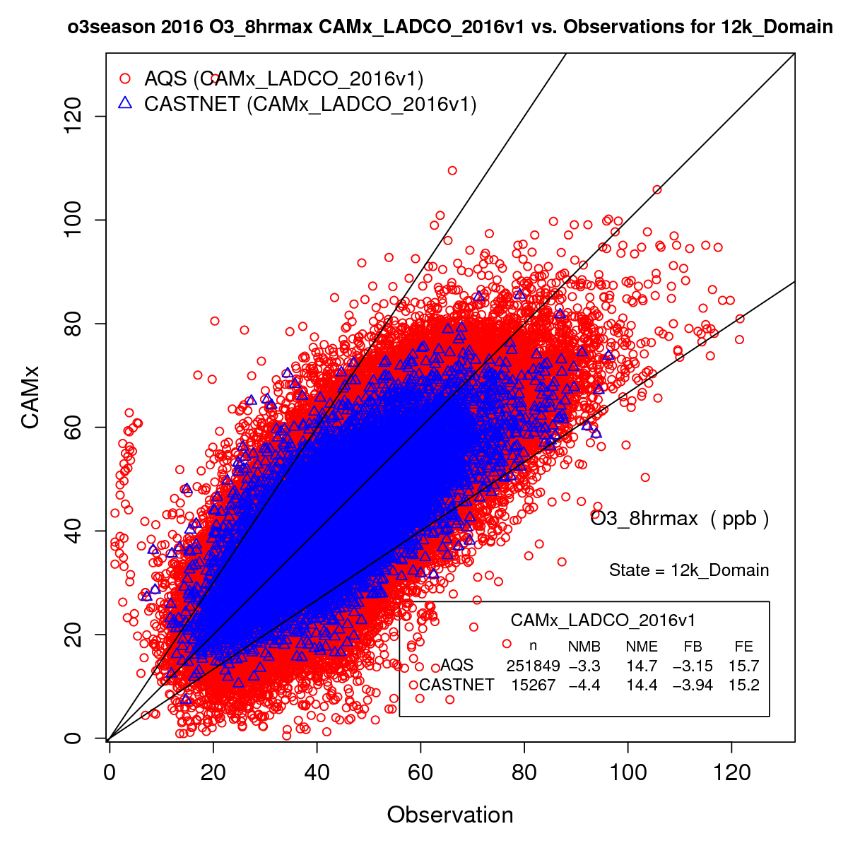
Daily Max 8-Hour Ozone (MDA8) Performance
National MDA8 O3 Season (April-October)
All AQS and CastNET sites
NMB/E = Normalized Mean Bias/Error
FB/E = Fractional Bias/Error
 | NMB | NME | FB | FE
AQS | -3.3 | 14.7 | -3.2 | 15.7
CastNET | -4.4 | 14.4 | -3.9 | 15.2

Slide 50
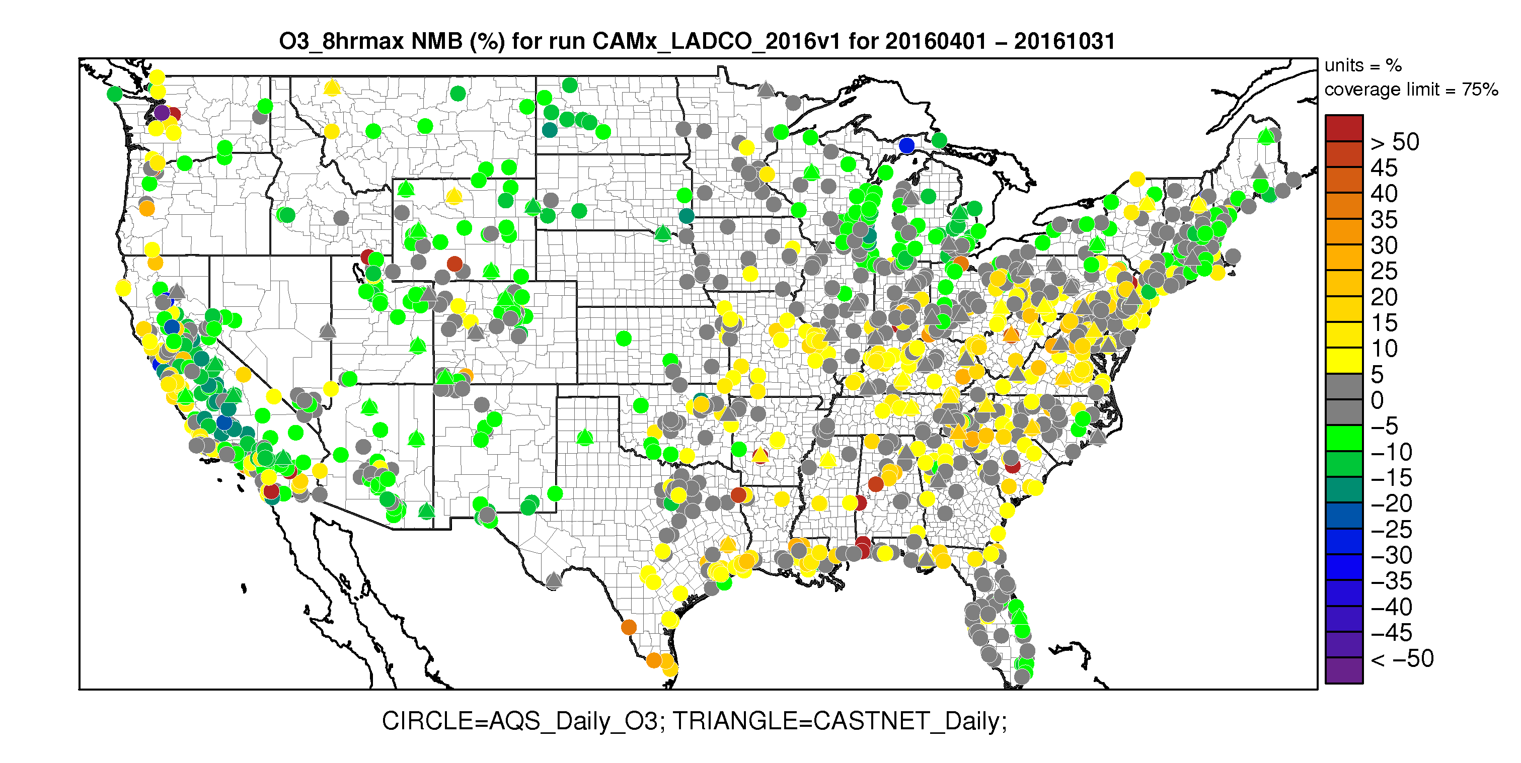
O3 Season MDA8 O3 Normalized Mean Bias

Slide 51
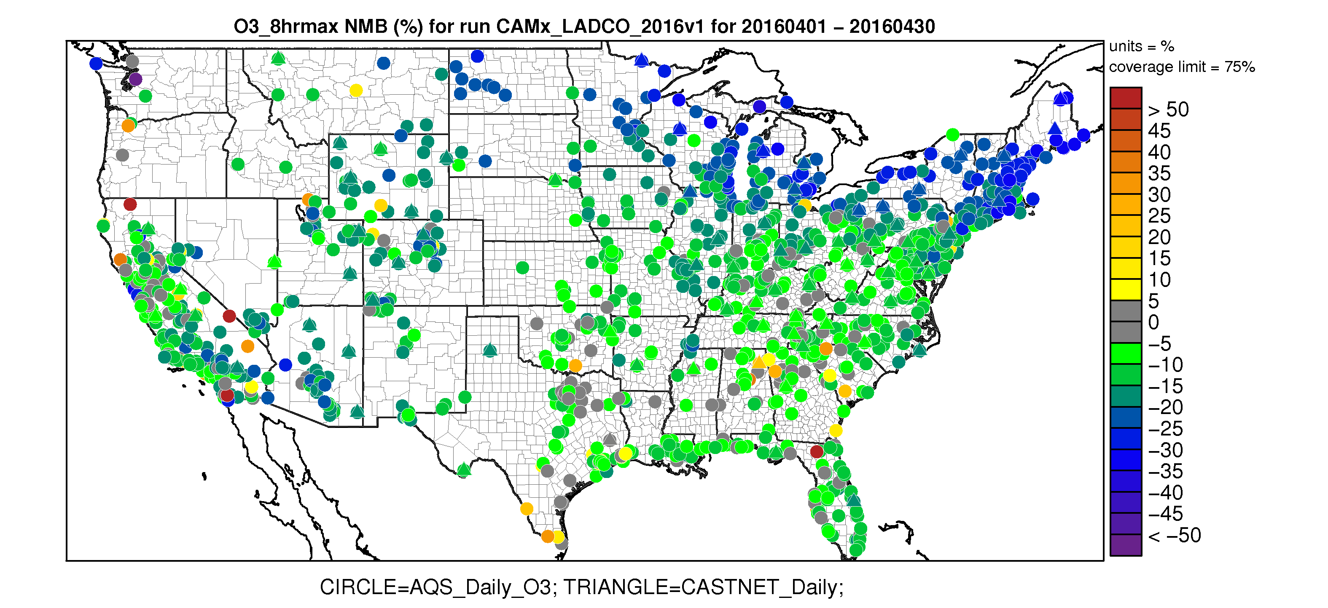
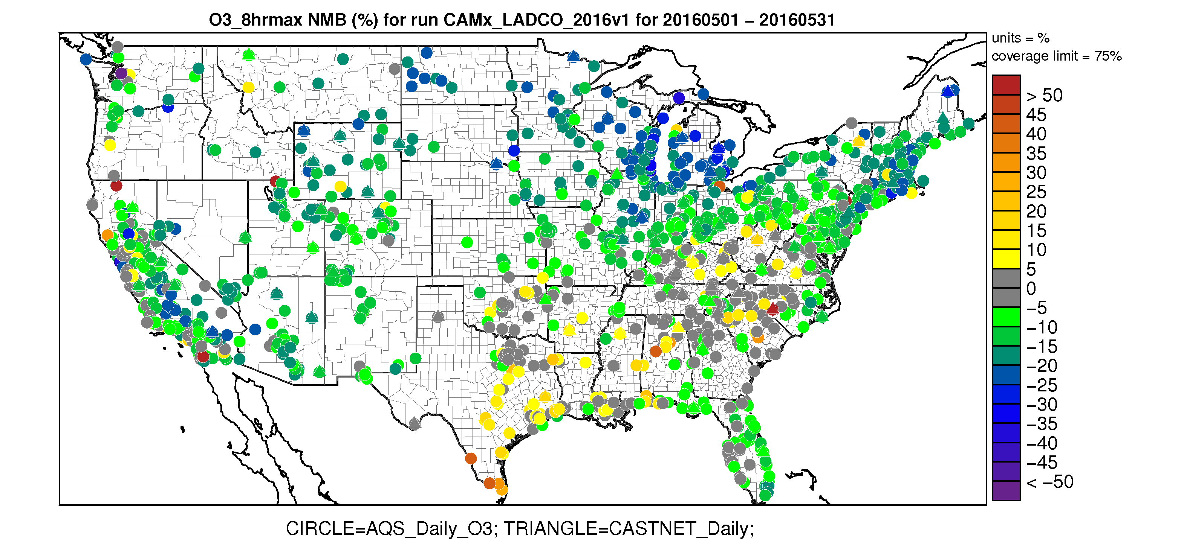
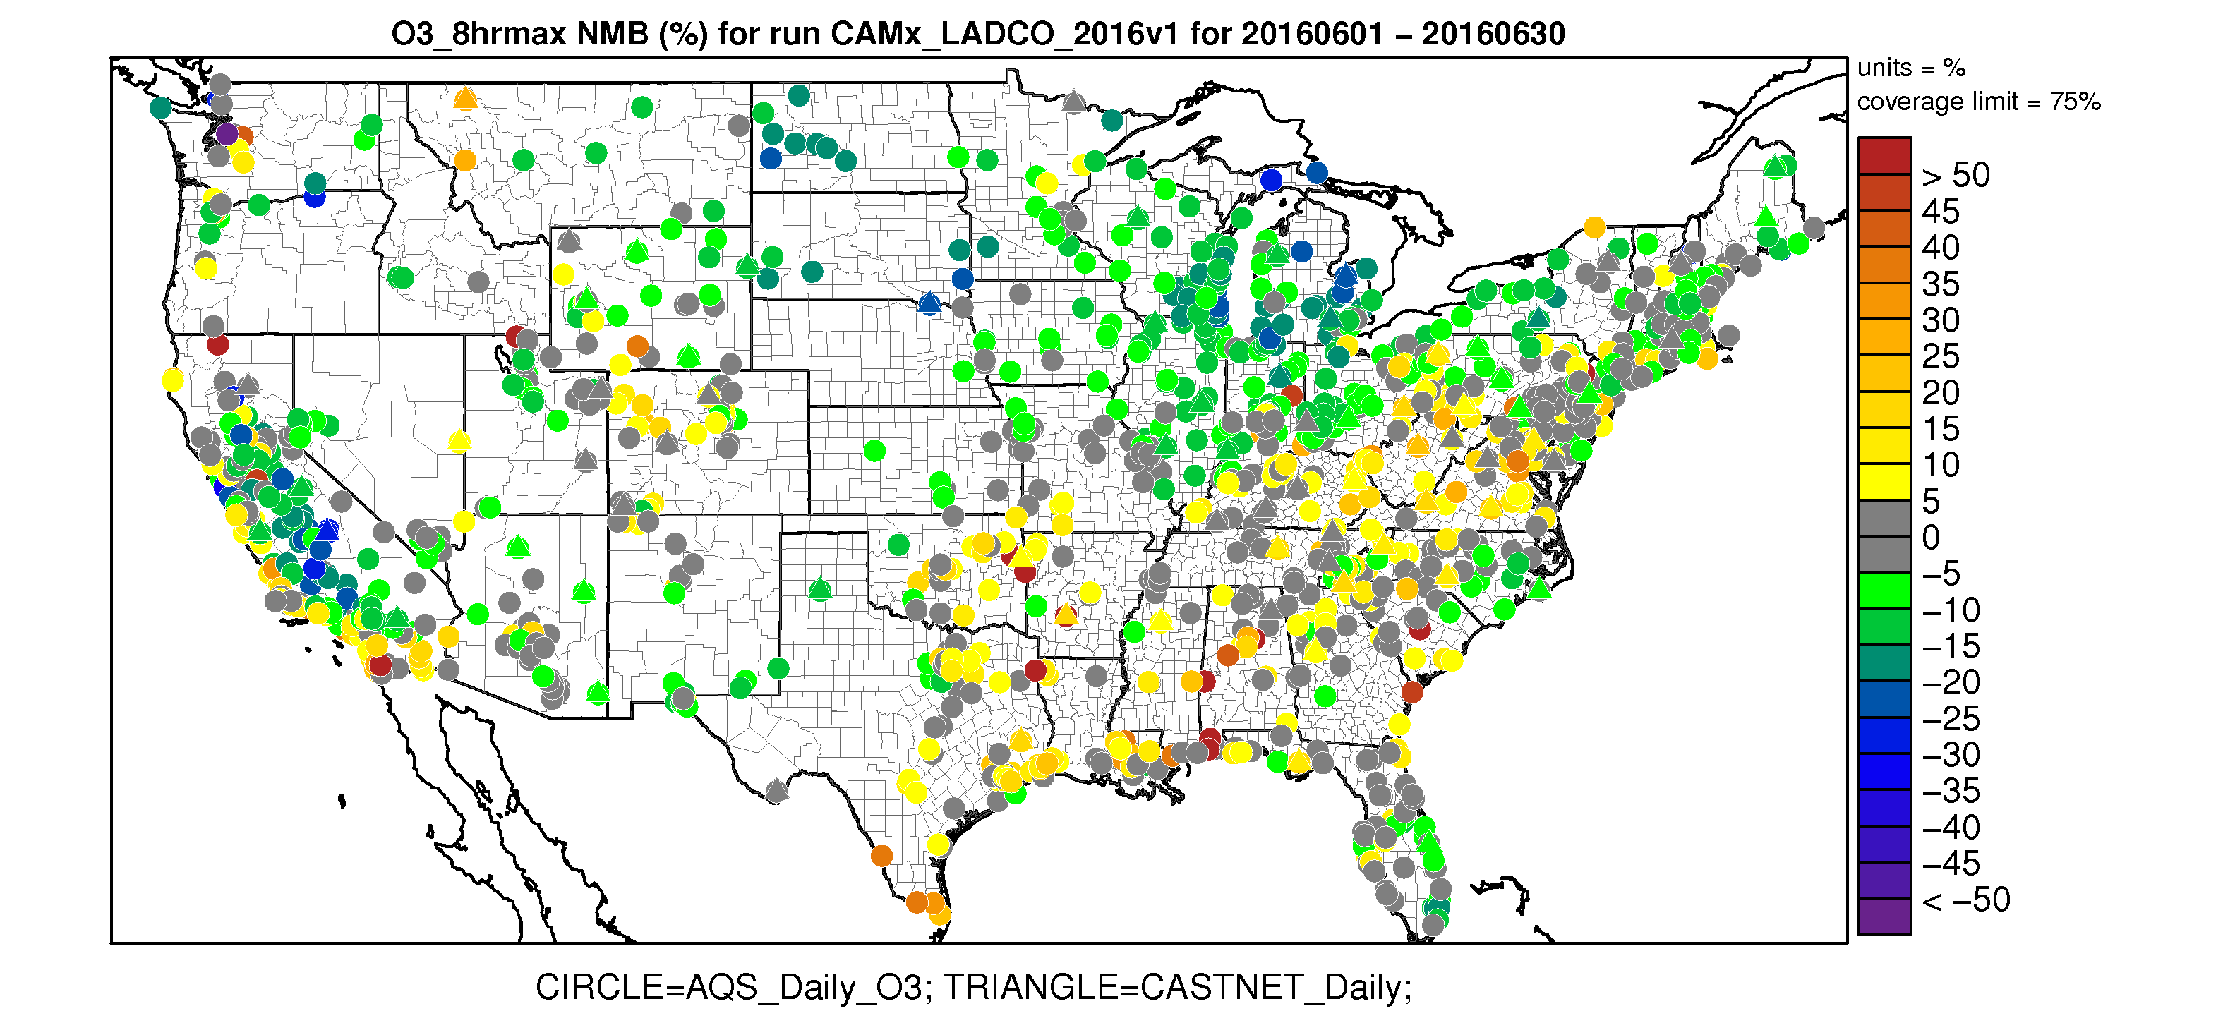
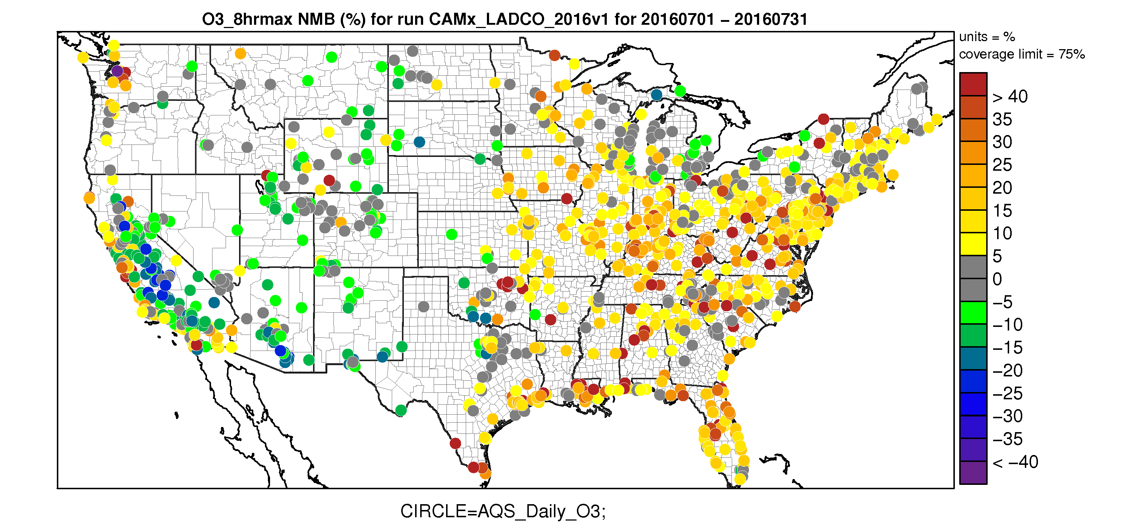
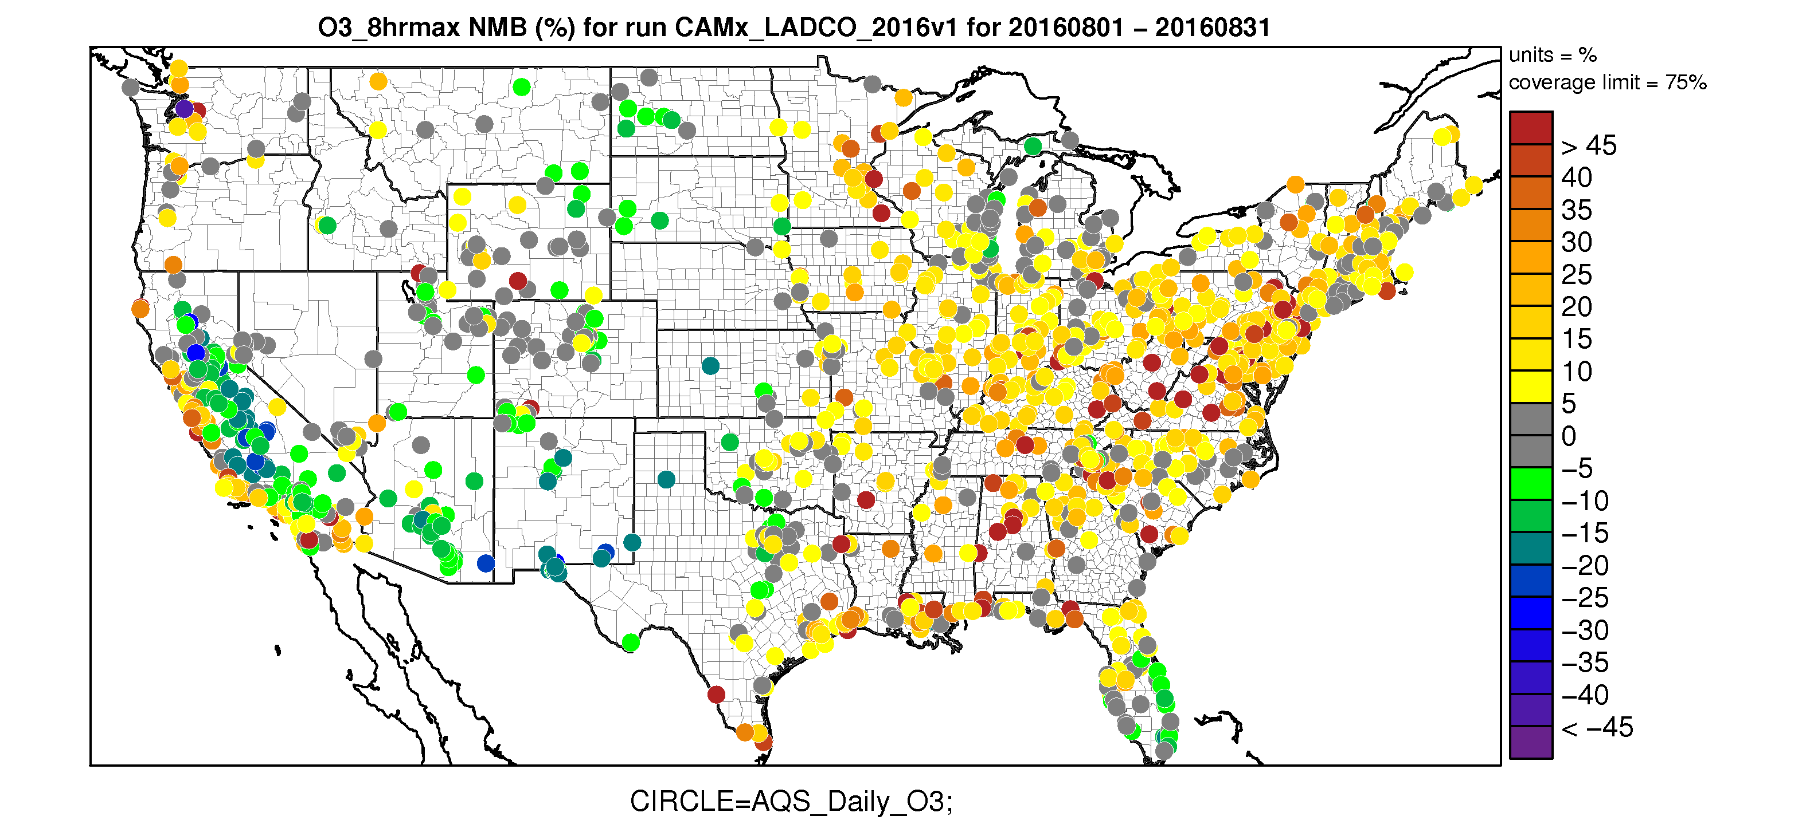
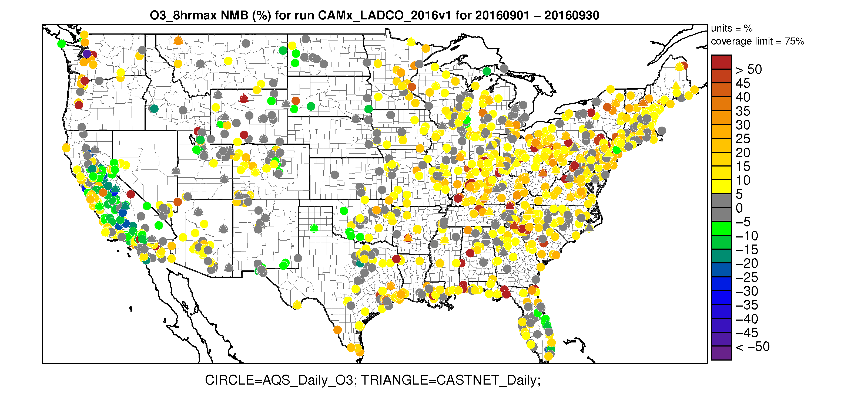
Monthly MDA8 O3 Normalized Mean Bias
April May June
July August September

Slide 52
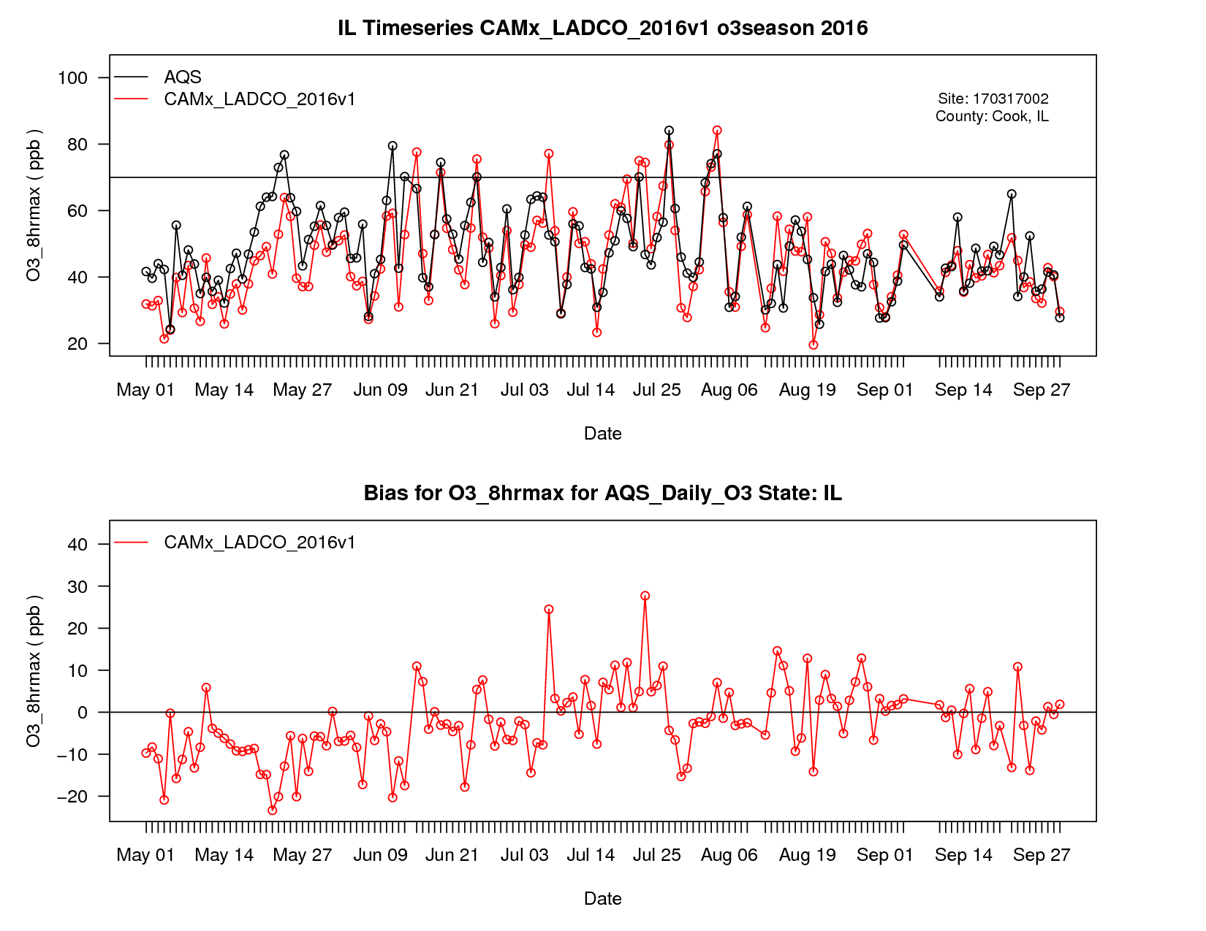
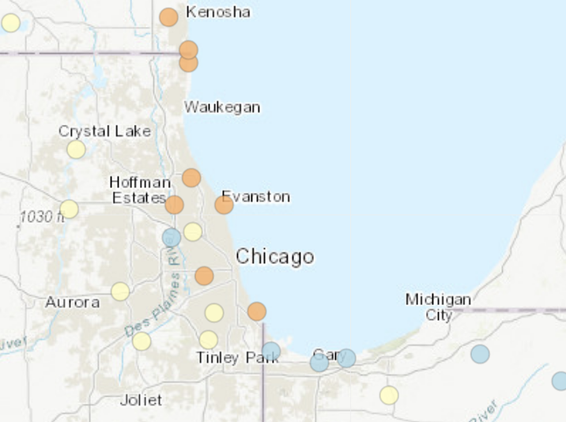
MDA8 O3
May-Sept
Time Series
Evanston, IL

Slide 53
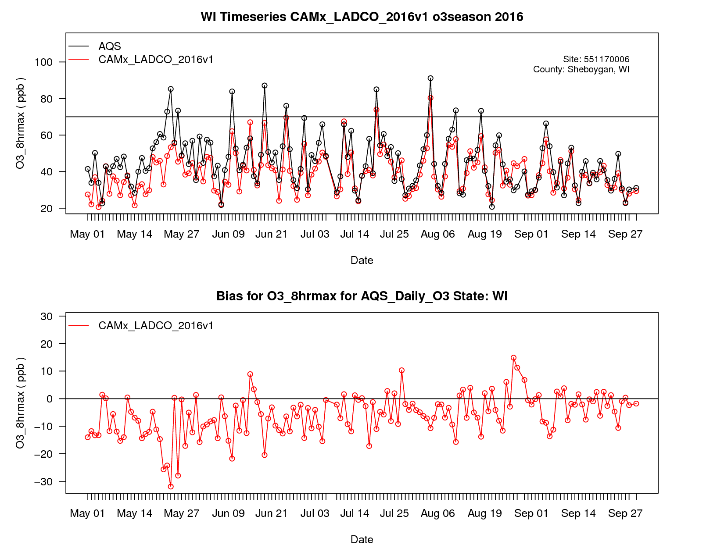
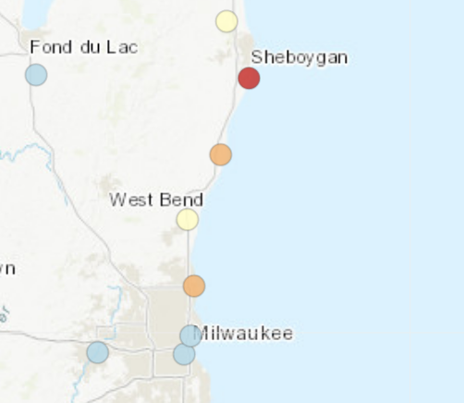
MDA8 O3
May-Sept
Time Series
Sheboygan, WI

Slide 54
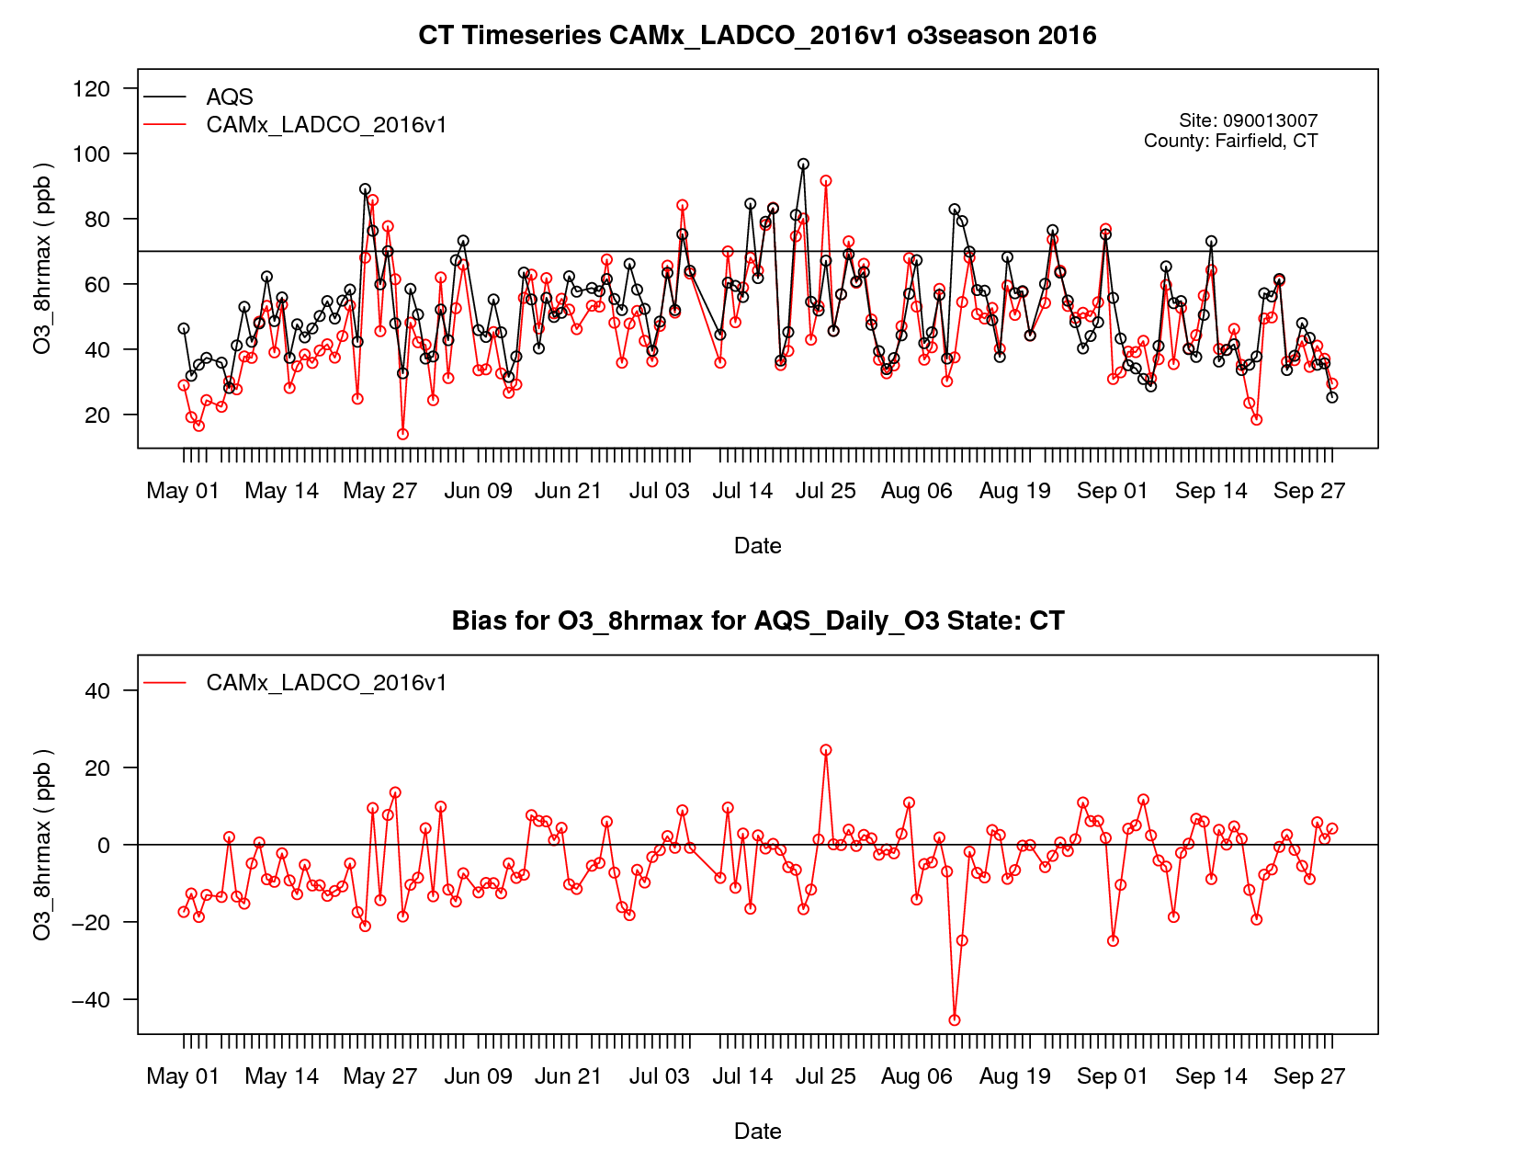
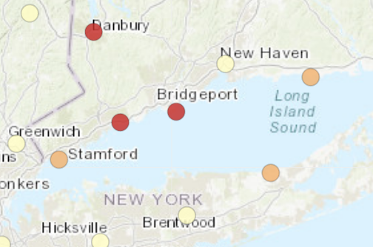
MDA8 O3
May-Sept
Time Series
Fairfield, CT

Slide 55
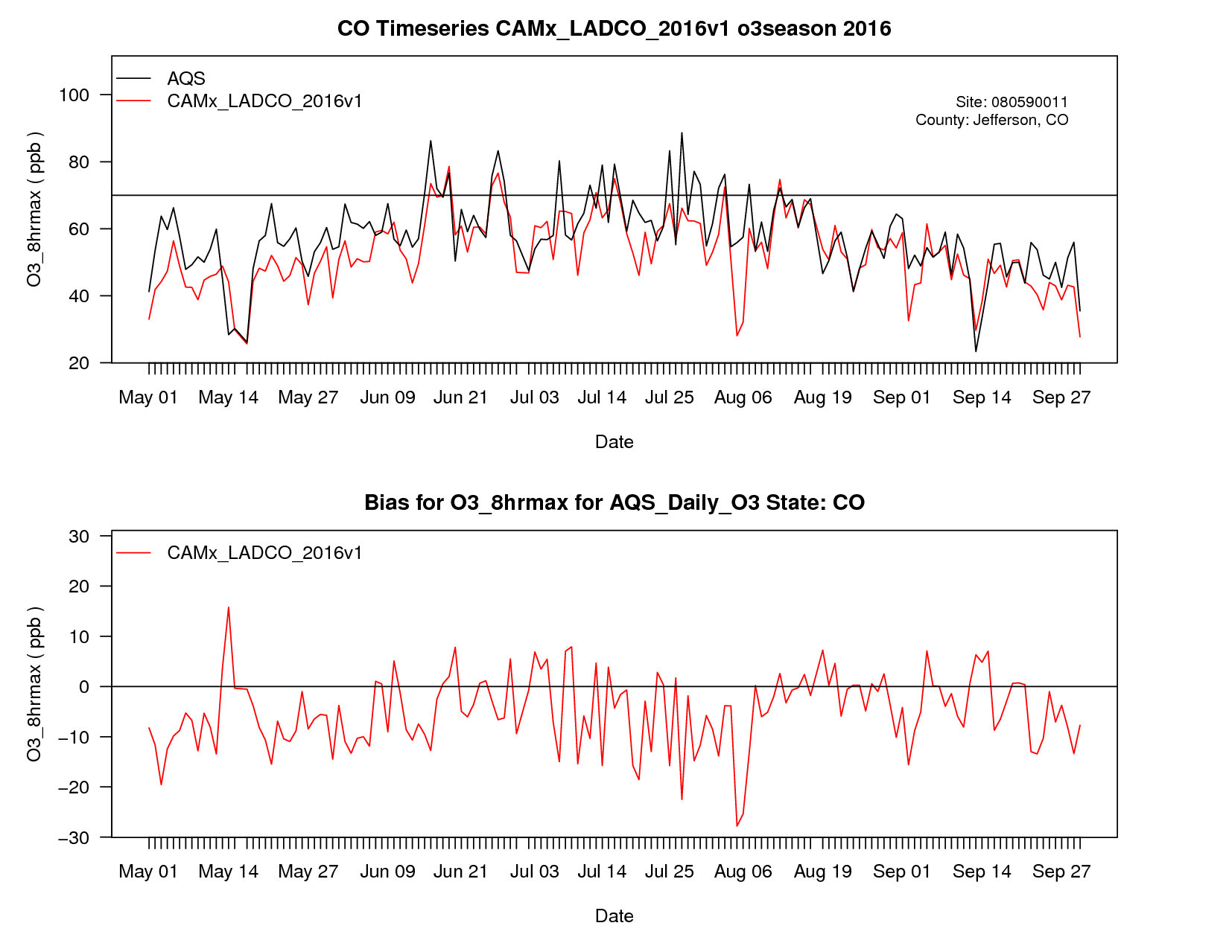
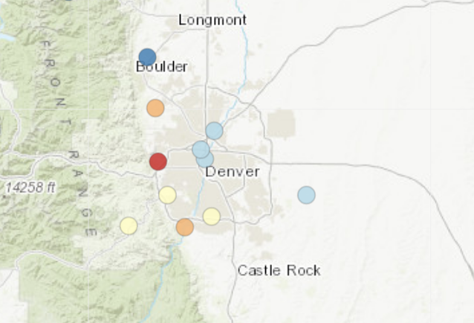
MDA8 O3
May-Sept
Time Series
Denver (NREL), CO

Slide 56
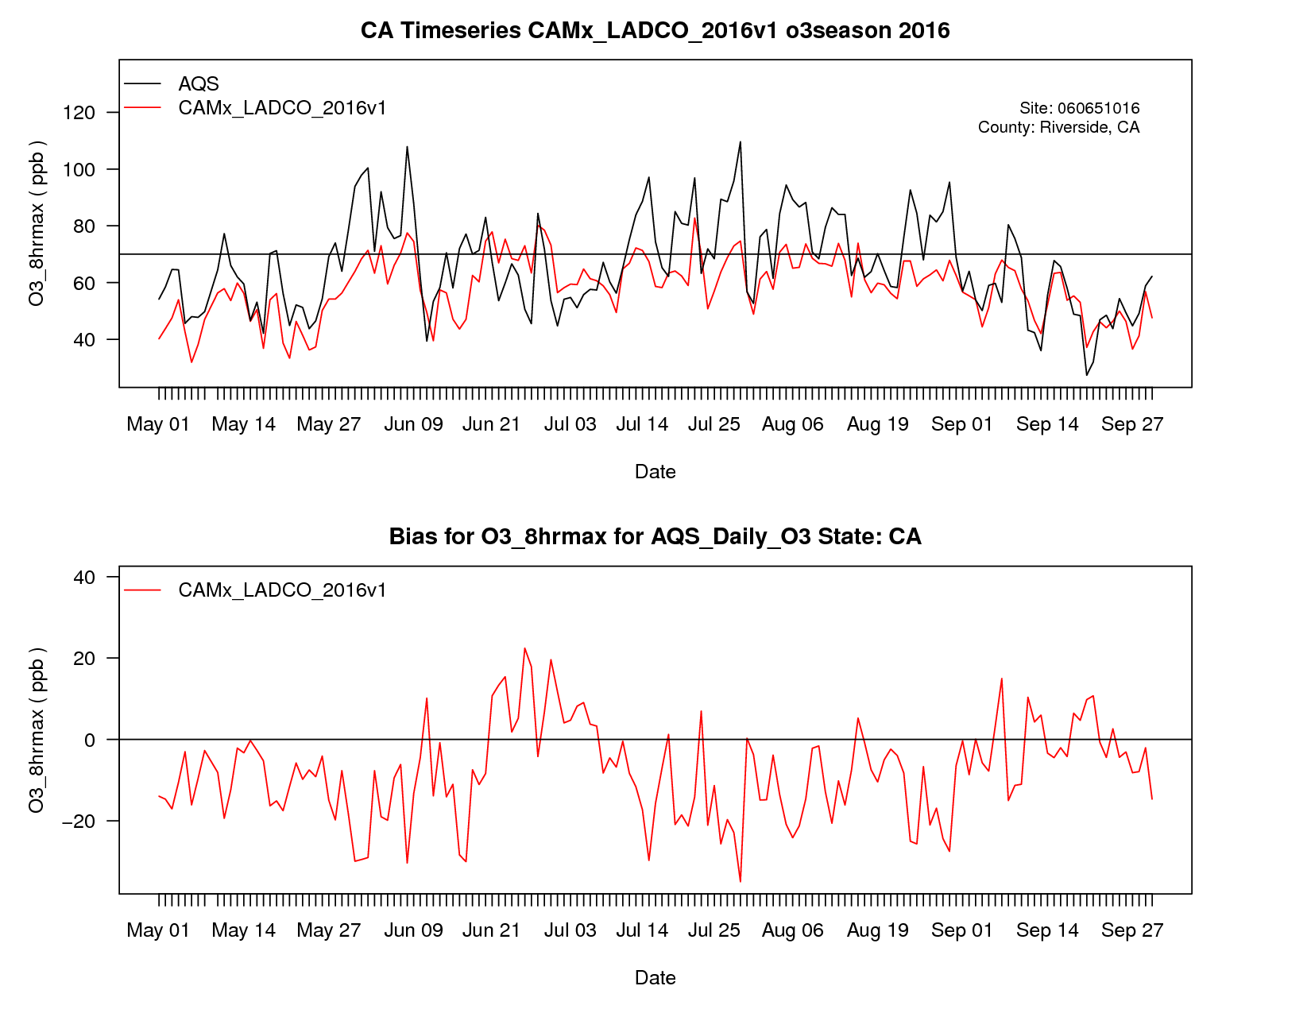
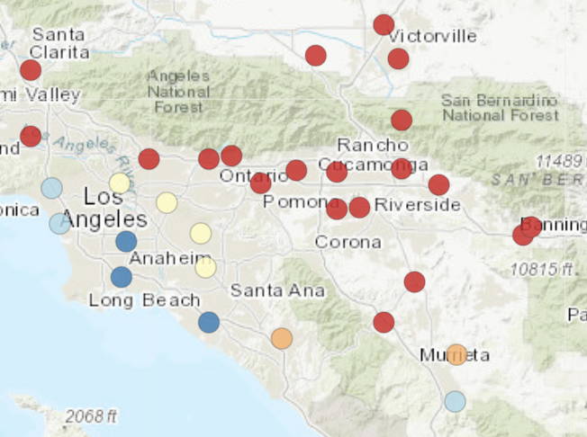
MDA8 O3
May-Sept
Time Series
Banning, CA

Slide 57
LADCO O3 MPE Summary
Preliminary evaluation of LADCO CAMx modeling
Model is underestimating observed MDA8 ozone
  April everywhere
  May – June everywhere outside of the southeast
  Entire ozone season inland California
Model is overestimating observed MDA8 ozone
  July-September in the eastern ½ of the country, coastal CA, and the Pacific NW

Slide 58
LADCO O3 MPE Next Steps
Compare LADCO, EPA, NY and others modeling results
Diagnose causes of model biases
Propose and test model performance improvements
  Meteorology, boundary conditions, emissions, model physics, chemistry

Slide 59
Preliminary results of CMAQ modeling comparisons
Jeongran Yu, NYSDEC

Slide 60
Modeling comparisons
1) 2016ff, CMAQ v5.2.1
2) 2016ff, CMAQ v5.3
3) 2016fh, CMAQ v5.3.1

Slide 61
Modeling components
 | 2016 beta platform modeling | 2016 V1 platform modeling
Emissions | 2016 beta (ff) emissions inventory | 2016 V1 (fh) emissions inventory
EGU point | IPM | IPM
Meteorology | WRF v3.8, MCIP v4.3 (provided by EPA) | WRF v3.8 (provided by EPA), MCIP v5.0 (processed by NYSDEC)
Boundary/Initial conditions | Extracted from EPA’s 36 km CMAQ modeling output | 36US3 run using CMAQv5.3.1 and 2016 V1 emissions (NYSDEC)
Domain | Old OTC 12 km domain | New expanded OTC 12 km domain
Modeling period | May to August | April to October
Model layers | 35 | 35
Science options | offline beis, no WBDust model, no lightning NOx, M3dry, no NH3 bidi | offline beis, no WBDust model, no lightning NOx, M3dry, NH3 bidi
Model | 1) CMAQ v5.2.1 and 2) CMAQ v5.3 | CMAQ v5.3.1

Slide 62
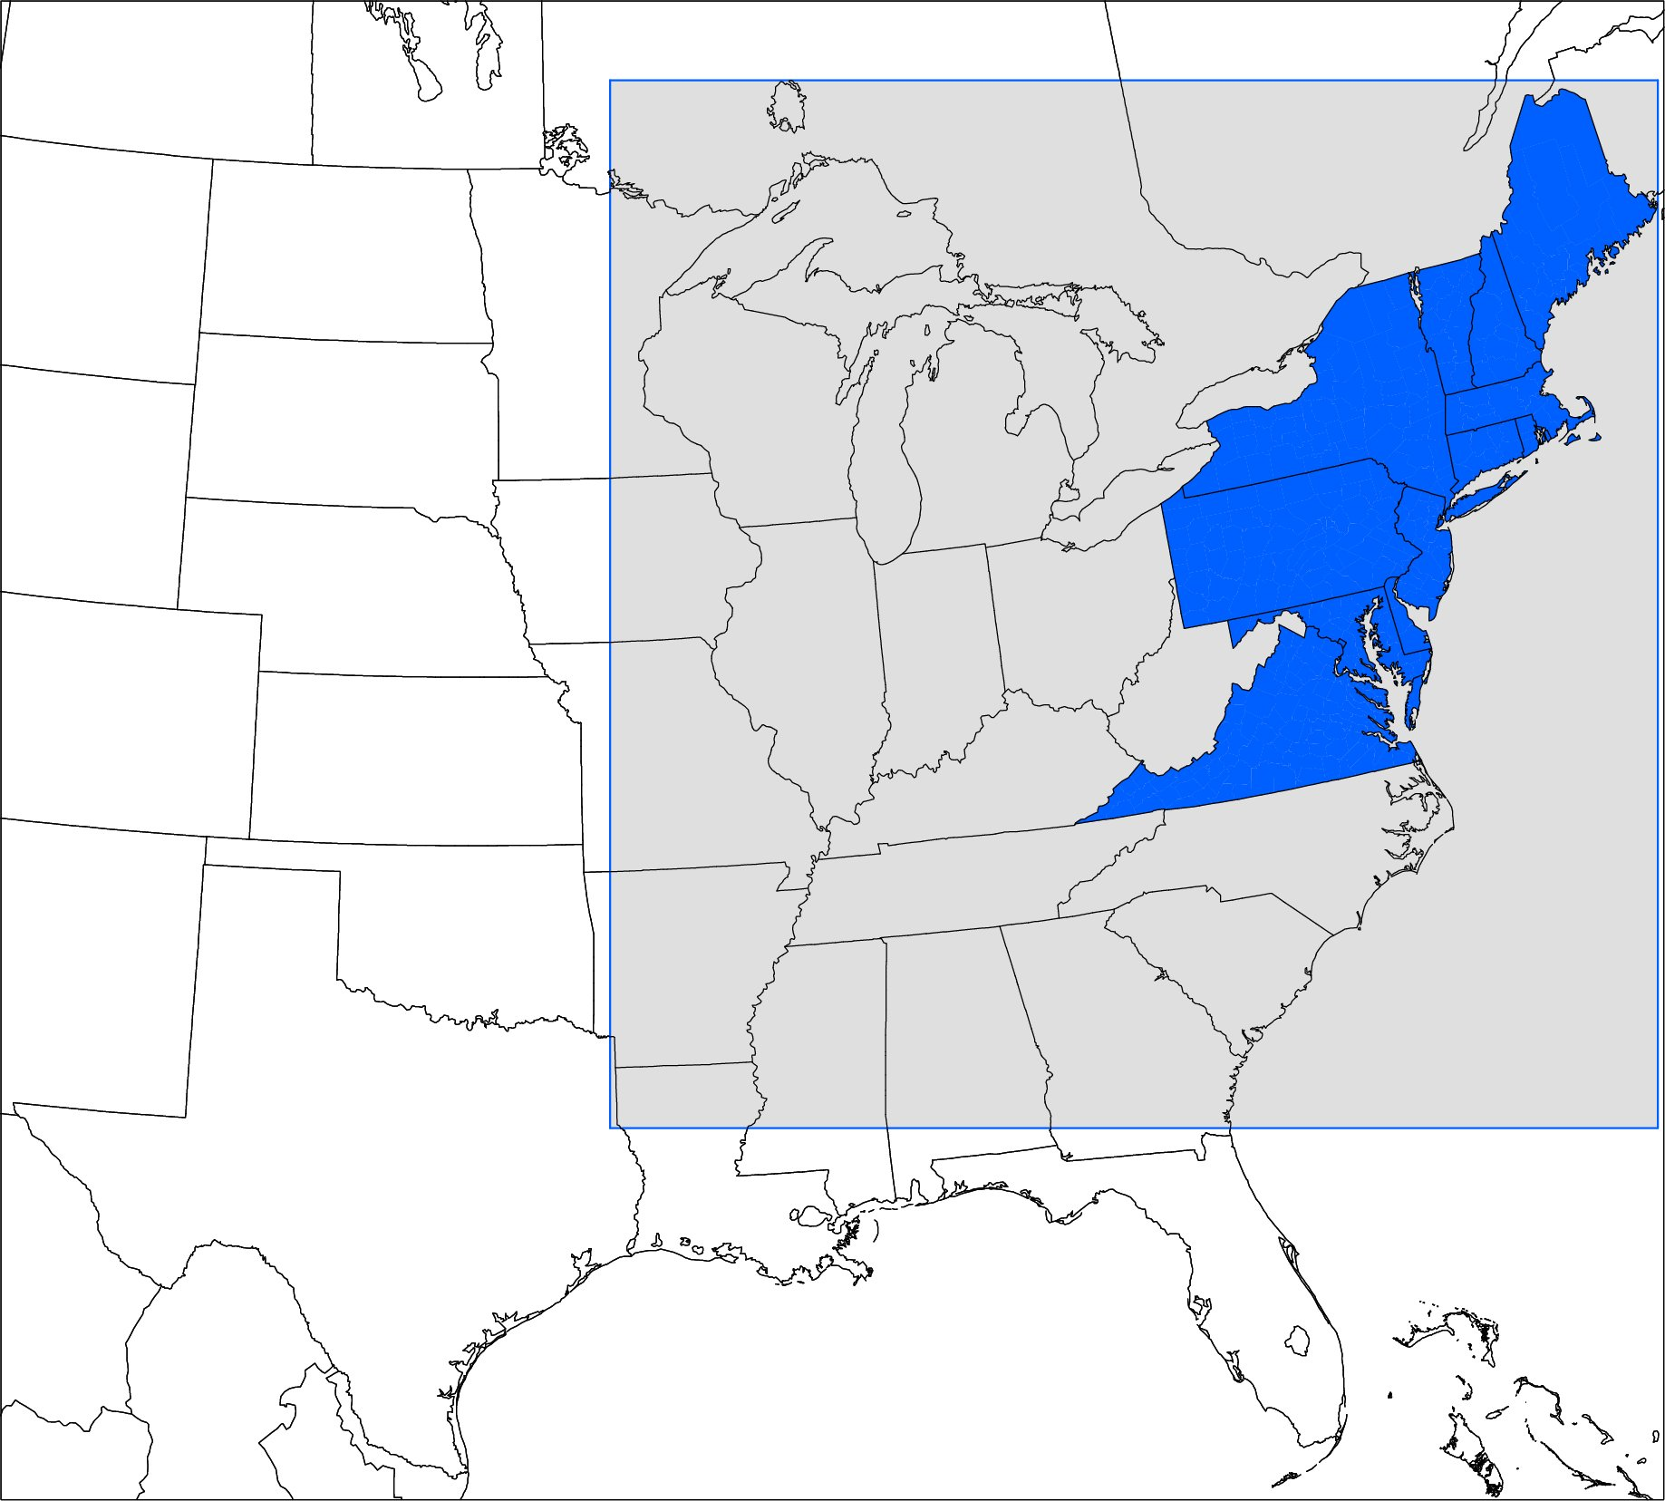
Modeling Domain
New OTC 12km
Old OTC 12km

Slide 63
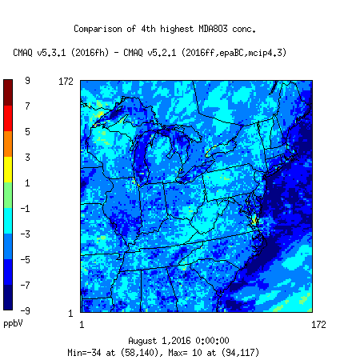
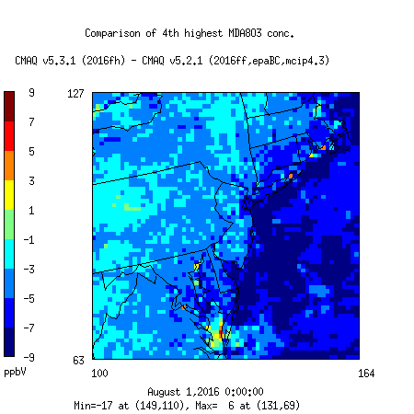
Comparison of 4th highest MDA8 O3 (May to Aug)

Slide 64
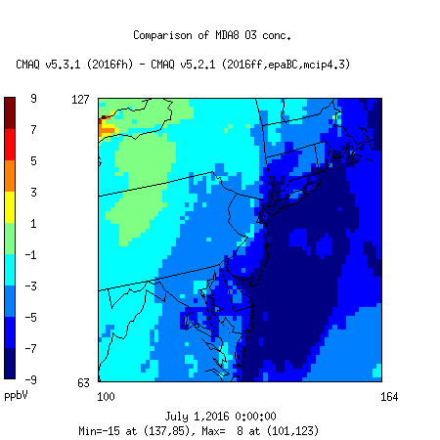
Comparisons of MDAO3 in July, 2016

Slide 65
Mean Bias with 60 ppb threshold

Slide 66






CMAQ v5.2.1, 2016ff
CMAQ v5.3, 2016ff
CMAQ v5.3.1, 2016fh
May-Jun
Jul-Aug

Slide 67





Comparisons of average hourly O3 in Nonattainment Areas in Northeast
ALL POINTS
MDA8 O3 >= 60 ppb
MAY
JUNE

Slide 68




Comparisons of average hourly O3 in Nonattainment Areas in Northeast
ALL POINTS
MDA8 O3 >= 60 ppb
JULY
AUG

Slide 69


Comparisons of average hourly O3 in Nonattainment Areas in Northeast
May to August, 2016
ALL POINTS
MDA8 O3 >= 60 ppb

Slide 70



Comparisons of average hourly O3 in Nonattainment Areas in Atlanta, GA
May to August, 2016
ALL POINTS
MDA8 O3 >= 60 ppb

Slide 71



Comparisons of average hourly O3 in Nonattainment Areas in Chicago, IL-IN-WI
May to August, 2016
ALL POINTS
MDA8 O3 >= 60 ppb

Slide 72

Location of selected analysis sites

Slide 73


Comparisons of MDA8 O3 timeseries in NY

Slide 74


Comparisons of MDA8 O3 timeseries at United Avenue and Cook County Sites

Slide 75
Conclusions
Have done various CMAQ modeling simulations using both 2016ff and 2016fh platforms.
In this presentation, three modeling results were compared.
Comparison of MDA8 O3 based on the 2016ff (CMAQ v5.2.1) and 2016fh (CMAQ v5.3.1) modeling shows overall decrease in ozone prediction in the domain: relatively large decrease over the ocean possibly due to CMAQ v5.3.1 ocean chemistry, and small decrease over the land partially due to emissions change.
However, some coastal areas show increase in ozone prediction possibly due to the adjustment of CMV emissions in the 2016fh platform
On average, for the NAA areas examined, ozone was underpredicted in early months and overpredicted in later months. And ozone was underpredicted for observed MDA8 O3>=60 ppb.

Slide 76
Regional haze application of the 2016v1 platform
Tom Moore, Western Regional Air Partnership

Slide 77




Lots of PM species variability at 100+ Class I areas in the western U.S.
Differences in magnitude, trends, species mix

Slide 78


Slide 79

Emission source sectors – moving from actual 2014 to Representative Baseline emissions
Anthropogenic source sectors are different between 2014v2 and RepBase scenarios
  2014v2: 35 sectors
  RepBase: 40 sectors
  CA stand alone and mostly remain the same except new fixes in Road Dust emissions for RepBase.
Natural sources:
  Fires: WRAP Fires; Different between 2014 actual fires vs. RepBase fires
  Others (including MEGAN, LNOx, SeaSalt, and WBD): same between 2014v2 and RepBase

Slide 80

Representative baseline and 2028 On The Books scenarios’ data sources

Slide 81


Slide 82

Developing ‘weight of evidence’ with model analyses
Future visibility projection
  What does haze respond to changes in future emissions?
Source apportionment
  Which states and sectors are contributing to haze?
  What is the contribution from prescribed wildland fires and international sources?
Area of influence / weighted emissions potential (AOI/WEP)
  Which significant emission sources are upwind?
Weight of evidence for developing RPG
Future visibility projection
AOI / WEP
Source apportionment

Slide 83






2028 most impaired and clearest projections w/ IMPROVE data trend

Slide 84

western U.S. source apportionment / sensitivity analyses
  Complementary approaches for Baseline and 2028 with tagging and zero-out sensitivity modeling scenarios
    Apply CAMx PSAT and APCA ‘tags’ for emissions by source region or sector
  Tagged emissions allow us to explicitly determine which sources are impacting downwind receptors
Example source sectors include:
  EGUs
  Mobile
  Oil & Gas
  Wild fires, Rx fires, ag fires
  Biogenic
  Lots of others, including boundaries, international

Slide 85

Example 2028 AOI / WEP at Mesa Verde NP (southwest Colorado)
Hysplit trajectories
Residence time analysis for Nitrate
AOI / WEP at Mesa Verde
+
=
Residence time analysis
NOx emissions

Slide 86

Further refine AOI / WEP by emission sector
Canyonlands National Park
Rank_Point at Allm Height & SO4/SO2
Relative Sector Contributions, see: https://views.cira.colostate.edu/iwdw/docs/emissions/WEP_Interim_Analysis_20200403.htm

Slide 87
Summary
WRAP has developed a modeling platform to investigate current and future air quality conditions for the western U.S.
  CAMx with inputs from WRF and GEOS-Chem
  Several sensitivity simulations and refinements to establish final version
  Emission inventories: base (2014), representative baseline (2014-18), future (2028)
  To apply for Regional Haze, ozone, nitrogen deposition, etc.
Three sets of analyses for developing reasonable progress goals (RPGs) at each Class I area
  Future haze estimates (visibility projections)
  Source apportionment (PSAT, APCA) and complementary zero-out sensitivity
  Area of influence/weighted emission potential (AOI/WEP)

Slide 88
January Webinar Survey Results and Next Steps

Slide 89

January 2020 Outreach Call Survey Results
26 total responses
Question 1) If you plan to use emissions data developed by the Emissions Collaborative, for which types applications will you use these data?

Slide 90

January 2020 Outreach Call Survey Results
Question 2) What other projection years do you envision will be needed in next 2-3 years?

Slide 91
January 2020 Outreach Call Survey Results
Question 3) What should the base year be for the next national emissions modeling platform? Is there a base year to avoid? Please explain
Answers:
Use an NEI year!!!
Most responses requested either 2017 or 2020

Slide 92
Inventory Collaborative Next Steps
Review of air quality modeling with 2016v1
Model projections off of the 2016 platform and evaluate air quality forecasts
Possible topics for next outreach call:
  Report out on air quality modeling results and performance evaluation
  Review future year forecasts and attainment tests
Does the community want another outreach call in August/September?

Slide 93
Inventory Collaborative Wiki Links
These slides and call notes:
http://views.cira.colostate.edu/wiki/wiki/11206
Main National Inventory Collaborative Wiki includes workgroup wikis, documentation, etc:
http://views.cira.colostate.edu/wiki/wiki/9169
LADCO Plot Viewer
https://www.ladco.org/technical/modeling-results/2016-inventory-collaborative/
IWDW Interactive Plotting Tool
http://vibe.cira.colostate.edu/iwdwx/Emissions/2016EMP

Slide 94
Appendix

Slide 95
Overview of the Platform Collaborative
A multi-purpose emissions modeling platform (EMP) is needed
  State Implementation Plans, federal analyses
  For the first time, EPA, states, and MJOs are engaging in collaborative EMP development
  The 2016 base year was selected via a collaborative process
Future years selected due to regulatory relevance
  2023 is relevant for Ozone NAAQS moderate areas
    2020 is being created by some states/regions for 2008 O3 NAAQS attainment demonstration modeling
  2028 for regional haze

Slide 96
2016 EMP Schedule
Several versions of 2016 platform were developed
  Alpha: preliminary version based on 2014NEIv2 for some and 2016 for other key sectors (released Spring, 2018)
    For initial testing of 2016 model runs
    Compatible versions of 2014 and 2015 were also released
    https://www.epa.gov/air-emissions-modeling/2014-2016-version-7-air-emissions-modeling-platforms
  Beta: improved and/or new version of actual 2016 emissions for most sectors (March 2019) and preliminary projected emissions for 2023 and 2028 (to workgroups in April 2019)
  V1.0: fully updated 2016 emissions and complete projected emissions for 2023 and 2028 (October 2019)

Slide 97
Organizational Structure
Coordination co-leads: Zac Adelman (LADCO) and Alison Eyth (EPA OAQPS)
  Developed process and communication structures, facilitate discussions, help resolve issues, documentation requirements, coordinate distribution of data to stakeholders
Coordination committee: regional, state, EPA leaders
  Define processes, resolve issues, co-lead workgroups
  Includes overall and WG co-leads plus MJO directors
Sector-specific Workgroups: one regional/state staff and one EPA staff (where possible)
  Focus on preparing emissions estimates for 2016 and future years, plus improve how the emissions sectors are modeled
  Include participants from EPA/states/locals/regions

